Slide 1
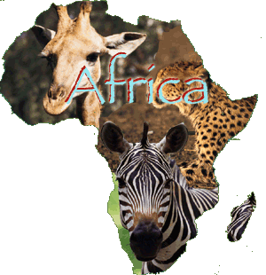
AFRICA: RELIEF AND WATERS

Slide 2
CHARACTERISTICS:
It is located between the _____________Sea , _____ , _________ Ocean and the __________ Ocean.
It is separated from Europe by the ______________.
It is separated from Asia by the ________ Peninsula and the ______ Sea.
It is the ___^{rd} largest continent ( _____ million km²)

Slide 3
AFRICAN RELIEF:
It is _____ but its average altitude is ______ (750m) due to its ____________ and ___________.
Landforms in Africa:
Plateaus: Bié / Katanga
Old massifs: Ethiopian Highlands / Tibetsi Mountains / Ahaggar Mountains
Depressions: Niger, Chad, River Congo
Geological Rifts: Rift Valley
Plains
Young mountain ranges: Atlas, Drakensberg Mountains

Slide 4
AFRICAN COASTS:
They have ____ coastal features.
The most important are:
Somali Peninsula (Horn of Africa)
Gulf of Guinea
Gulf of Aden
Cape of Good Hope
Cape of Guardafui
Island of Madagascar.

Slide 5
AFRICAN WATERS:
African rivers are quite ________ depending on where their waters flow to:
The rivers that flow into the Atlantic Ocean: are _____ and ____________. Ej: Congo river / Niger River / Orange River.
Rivers that flow into the Indian Ocean: are __________. Ej: Shabeelle river.
Rivers that flow into the Mediterranean Sea: are _______ and have little _______, except for the Nile river, which is also the __________ river in the world. In this desert area there are ___________ (channels in which rivers flow) that remain dry most of the year, known as “_______” in Arabic.
There are many lakes in the area of the Rift Valley. Ej: Lake Victoria, Lake Tanganica, Lake Albert.

Slide 6
PLATEAUS
Darfur Plateau
Adamawa
plateau
Bié plateau
Katanga plateau
S. African plateau

Slide 7
MOUNTAIN RANGES
Atlas mountains
Ahaggar Mts.
Tibesti Mts.
Marra Mts.
Darfur Plateau
Bongos Mts.
Ethiopian Highlands
Adamawa
plateau
Ruwenzori
Mitumba
Bié plateau
Katanga plateau
Muchinga Mts.
S. African plateau
Drakensberg Mts.

Slide 8
peaks
Atlas mountains
Ahaggar Mts.
Tibesti Mts.
Marra Mts.
Darfur Plateau
Bongos Mts.
Ethiopian Highlands
Adamawa
plateau
Mt. Stanley
Mt. Kenya
Mitumb Mts.
Mt. Kilimanjaro
Bié plateau
Katanga plateau
Muchinga Mts.
S. African plateau
Drakensberg Mts.

Slide 9
depressions
Atlas mountains
Ahaggar Mts.
Tibesti Mts.
Niger basin
Chad
basin
Marra Mts.
Darfur Plateau
Bongos Mts.
Ethiopian Highlands
Adamawa
plateau
Congo
basin
Mt. Stanley
Mt. Kenya
Mitumb Mts.
Mt. Kilimanjaro
Bié plateau
Katanga plateau
Muchinga Mts.
S. African plateau
Drakensberg Mts.

Slide 10
deserts
Atlas mountains
SAHARA DESERT
Ahaggar Mts.
LIBYAN DESERT
Tibesti Mts.
Niger basin
Chad
basin
Marra Mts.
Darfur Plateau
Bongos Mts.
Ethiopian Highlands
Adamawa
plateau
Congo
basin
Mt. Stanley
Mt. Kenya
Mitumb Mts.
Mt. Kilimanjaro
Bié plateau
Katanga plateau
Muchinga Mts.
S. African plateau
Kalahari Desert
Namib Desert
Drakensberg Mts.

Slide 11
VALLEYS
Atlas mountains
SAHARA DESERT
Ahaggar Mts.
LIBYAN DESERT
Tibesti Mts.
Niger basin
SAHEL
Marra Mts.
Chad
basin
Darfur Plateau
Sudan Valley
Bongos Mts.
Ethiopian Highlands
Adamawa
plateau
VALLEY
Congo
basin
Mt. Stanley
Mt. Kenya
Mitumb Mts.
Mt. Kilimanjaro
G. RIFT
G. RIFT VALLEY
Bié plateau
Katanga plateau
Muchinga Mts.
S. African plateau
Kalahari Desert
Namib Desert
Drakensberg Mts.

Slide 12
ISLANDS
Madeira
Atlas mountains
Canary Islands
SAHARA DESERT
Ahaggar Mts.
LIBYAN DESERT
Tibesti Mts.
Cape Verde Islands
Niger basin
SAHEL
Marra Mts.
Chad
basin
Darfur Plateau
Sudan Valley
Bongos Mts.
Ethiopian Highlands
Adamawa
plateau
VALLEY
Bioko
Principe
Congo
basin
Mt. Stanley
Mt. Kenya
Sâo Tomé
Mitumb Mts.
Mt. Kilimanjaro
G. RIFT
Seychelles Islands
G. RIFT VALLEY
Zanzibar
Bié plateau
Katanga plateau
Comoros Islands
Muchinga Mts.
S. African plateau
MADAGASCAR
Mauritius
Kalahari Desert
Namib Desert
Reunion
Drakensberg Mts.

Slide 13
GULFS
Gulf of Gabes
Madeira
Atlas mountains
Gulf of Sirte
Canary Islands
SAHARA DESERT
Ahaggar Mts.
LIBYAN DESERT
Tibesti Mts.
Cape Verde Islands
Niger basin
SAHEL
Marra Mts.
Chad
basin
Darfur Plateau
Sudan Valley
Gulf of Aden
Bongos Mts.
Ethiopian Highlands
Adamawa
plateau
VALLEY
Bioko
Biafra G.
Principe
Congo
basin
Mt. Stanley
Mt. Kenya
Sâo Tomé
Gulf of Guinea
Mitumb Mts.
G. RIFT
Mt. Kilimanjaro
Seychelles Islands
G. RIFT VALLEY
Zanzibar
Gulf of Benguela
Katanga plateau
Comoros Islands
Bié plateau
Muchinga Mts.
S. African plateau
MADAGASCAR
Mauritius
Kalahari Desert
Namib Desert
Reunion
Drakensberg Mts.

Slide 14
CAPES
Gulf of Gabes
Madeira
Atlas mountains
Gulf of Sirte
Canary Islands
SAHARA DESERT
Cape Bojador
Ahaggar Mts.
Cape Blanc
LIBYAN DESERT
Tibesti Mts.
Cape Verde Islands
Cape Verde
Niger basin
SAHEL
Marra Mts.
Chad
basin
Darfur Plateau
Sudan Valley
Gulf of Aden
Cape Guardafuí
Bongos Mts.
Ethiopian Highlands
Adamawa
plateau
VALLEY
Cape Palmas
Bioko
Biafra G.
Principe
Congo
basin
Mt. Stanley
Mt. Kenya
Sâo Tomé
Gulf of Guinea
Cape Lopez
Mitumb Mts.
G. RIFT
Mt. Kilimanjaro
Seychelles Islands
G. RIFT VALLEY
Zanzibar
Gulf of Benguela
Cape Delgado
Bié plateau
Katanga plateau
Comoros Islands
Muchinga Mts.
Cape Fria
S. African plateau
MADAGASCAR
Mauritius
Kalahari Desert
Namib Desert
Reunion
Drakensberg Mts.
Cape of Good Hope
Cape Agulhas

Slide 15
PENINSULAS
Gulf of Gabes
Madeira
Atlas mountains
Gulf of Sirte
Canary Islands
Sinai Peninsula
SAHARA DESERT
Cape Bojador
Ahaggar Mts.
Cape Blanc
LIBYAN DESERT
Tibesti Mts.
Cape Verde Islands
Cape Verde
Niger basin
SAHEL
Marra Mts.
Chad
basin
Darfur Plateau
Sudan Valley
Gulf of Aden
Cape Guardafuí
Bongos Mts.
Ethiopian Highlands
Somali Peninsula
Adamawa
plateau
VALLEY
Cape Palmas
Bioko
Biafra G.
Principe
Congo
basin
Mt. Stanley
Mt. Kenya
Sâo Tomé
Gulf of Guinea
Cape Lopez
Mitumb Mts.
G. RIFT
Mt. Kilimanjaro
Seychelles Islands
G. RIFT VALLEY
Zanzibar
Gulf of Benguela
Cape Delgado
Bié plateau
Katanga plateau
Comoros Islands
Muchinga Mts.
Cape Fria
S. African plateau
MADAGASCAR
Mauritius
Kalahari Desert
Namib Desert
Reunion
Drakensberg Mts.
Cape of Good Hope
Cape Agulhas

Slide 16
STRAITS
Strait of Gibraltar
Gulf of Gabes
Madeira
Atlas mountains
Gulf of Sirte
Canary Islands
Sinai Peninsula
SAHARA DESERT
Cape Bojador
Ahaggar Mts.
Cape Blanc
LIBYAN DESERT
Tibesti Mts.
Bab el Mandeb
Cape Verde Islands
Cape Verde
Niger basin
SAHEL
Marra Mts.
Chad
basin
Darfur Plateau
Sudan Valley
Gulf of Aden
Cape Guardafuí
Bongos Mts.
Ethiopian Highlands
Somali Peninsula
Adamawa
plateau
VALLEY
Cape Palmas
Bioko
Biafra G.
Principe
Congo
basin
Mt. Stanley
Mt. Kenya
Sâo Tomé
Gulf of Guinea
Cape Lopez
Mitumb Mts.
G. RIFT
Mt. Kilimanjaro
Seychelles Islands
G. RIFT VALLEY
Zanzibar
Gulf of Benguela
Cape Delgado
Bié plateau
Katanga plateau
Comoros Islands
Muchinga Mts.
Cape Fria
S. African plateau
Mozambique Channel
MADAGASCAR
Mauritius
Kalahari Desert
Namib Desert
Reunion
Drakensberg Mts.
Cape of Good Hope
Cape Agulhas

Slide 17
SEAS & OCEANS
Strait of Gibraltar
MEDITERRANEAN SEA
Gulf of Gabes
Madeira
Atlas mountains
Gulf of Sirte
Canary Islands
Sinai Peninsula
SAHARA DESERT
Cape Bojador
Ahaggar Mts.
Cape Blanc
LIBYAN DESERT
Tibesti Mts.
RED SEA
Bab el Mandeb
Cape Verde Islands
Cape Verde
Niger basin
SAHEL
Marra Mts.
Chad
basin
Darfur Plateau
Sudan Valley
Gulf of Aden
Cape Guardafuí
Bongos Mts.
Ethiopian Highlands
Somali Peninsula
Adamawa
plateau
VALLEY
INDIAN
OCEAN
Cape Palmas
Bioko
Biafra G.
Principe
Congo
basin
Mt. Stanley
Mt. Kenya
Sâo Tomé
Gulf of Guinea
Cape Lopez
Mitumb Mts.
G. RIFT
Mt. Kilimanjaro
Seychelles Islands
G. RIFT VALLEY
Zanzibar
ATLANTIC
OCEAN
Gulf of Benguela
Cape Delgado
Bié plateau
Katanga plateau
Comoros Islands
Muchinga Mts.
Cape Fria
S. African plateau
Mozambique Channel
MADAGASCAR
Mauritius
Kalahari Desert
Namib Desert
Reunion
Drakensberg Mts.
Cape of Good Hope
Cape Agulhas

Slide 18
rivers
Strait of Gibraltar
MEDITERRANEAN SEA
Gulf of Gabes
Madeira
Atlas mountains
Gulf of Sirte
Canary Islands
Sinai Peninsula
SAHARA DESERT
Cape Bojador
Ahaggar Mts.
Nile R.
Cape Blanc
LIBYAN DESERT
Tibesti Mts.
RED SEA
Bab el Mandeb
Cape Verde Islands
Cape Verde
Senegal R.
Niger basin
SAHEL
Marra Mts.
Chad
basin
Darfur Plateau
Sudan Valley
Niger R.
Gulf of Aden
Cape Guardafuí
Gambia R.
Ethiopian Highlands
Somali Peninsula
Adamawa
plateau
Bongos Mts.
VALLEY
INDIAN
OCEAN
Cape Palmas
Bioko
Shabeelle R.
Biafra G.
Principe
Congo
basin
Mt. Stanley
Mt. Kenya
Sâo Tomé
Gulf of Guinea
Cape Lopez
Mitumb Mts.
Congo R.
G. RIFT
Mt. Kilimanjaro
Seychelles Islands
G. RIFT VALLEY
Zanzibar
ATLANTIC
OCEAN
Gulf of Benguela
Cape Delgado
Bié plateau
Katanga plateau
Comoros Islands
Muchinga Mts.
Cape Fria
S. African plateau
Zambeze R.
Mozambique Channel
MADAGASCAR
Mauritius
Kalahari Desert
Namib Desert
Limpopo R.
Reunion
Orange R.
Drakensberg Mts.
Cape of Good Hope
Cape Agulhas

Slide 19
LAKES
Strait of Gibraltar
MEDITERRANEAN SEA
Gulf of Gabes
Madeira
Atlas mountains
Gulf of Sirte
Canary Islands
Sinai Peninsula
SAHARA DESERT
Cape Bojador
Ahaggar Mts.
Nile R.
Cape Blanc
LIBYAN DESERT
Tibesti Mts.
RED SEA
Bab el Mandeb
Cape Verde Islands
Cape Verde
Senegal R.
Niger basin
SAHEL
Marra Mts.
Chad
basin
Niger R.
Lake Chad
Darfur Plateau
Sudan Valley
Gulf of Aden
Gambia R.
Cape Guardafuí
Lake Volta
Bongos Mts.
Ethiopian Highlands
Somali Peninsula
Adamawa
plateau
Lake Turkana
VALLEY
INDIAN
OCEAN
Cape Palmas
Bioko
Shabeelle R.
Biafra G.
Lake Albert
Principe
Congo
basin
Mt. Stanley
Mt. Kenya
Sâo Tomé
Gulf of Guinea
Lake Victoria
Cape Lopez
Mitumb Mts.
Congo R.
G. RIFT
Mt. Kilimanjaro
Seychelles Islands
G. RIFT VALLEY
Zanzibar
Lake Tanganika
Cape Delgado
ATLANTIC
OCEAN
Gulf of Benguela
Katanga plateau
Comoros Islands
Bié plateau
Muchinga Mts.
Lake Malawi
Lake Bangweulu
Cape Fria
S. African plateau
Zambeze R.
Mozambique Channel
MADAGASCAR
Mauritius
Kalahari Desert
Namib Desert
Limpopo R.
Reunion
Orange R.
Drakensberg Mts.
Cape of Good Hope
Cape Agulhas

Slide 20
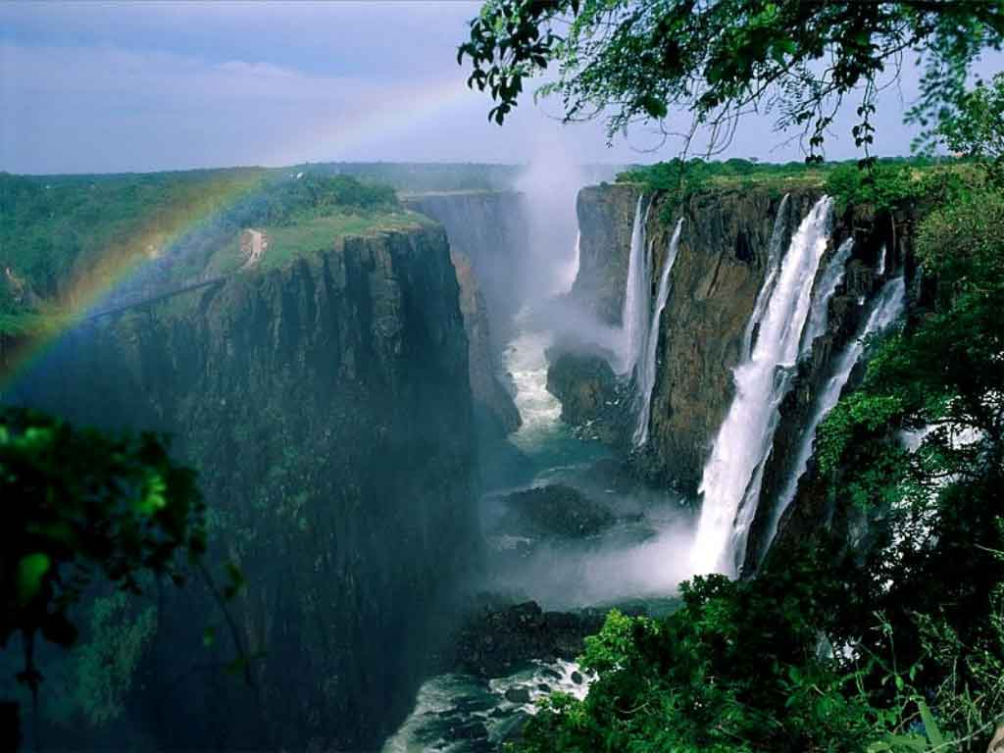
OTHERS
Strait of Gibraltar
MEDITERRANEAN SEA
Gulf of Gabes
Madeira
Atlas mountains
Gulf of Sirte
Nile Delta
Suez Canal
Canary Islands
Sinai Peninsula
SAHARA DESERT
Cape Bojador
Ahaggar Mts.
Nile R.
Cape Blanc
LIBYAN DESERT
Tibesti Mts.
RED SEA
Bab el Mandeb
Cape Verde Islands
Cape Verde
Senegal R.
Niger basin
SAHEL
Marra Mts.
Chad
basin
Niger R.
Lake Chad
Darfur Plateau
Sudan Valley
Gulf of Aden
Gambia R.
Cape Guardafuí
Bongos Mts.
Ethiopian Highlands
Somali Peninsula
Adamawa
plateau
Lake Turkana
VALLEY
INDIAN
OCEAN
Cape Palmas
Bioko
Shabeelle R.
Biafra G.
Lake Albert
Principe
Congo
basin
Mt. Stanley
Mt. Kenya
Sâo Tomé
Gulf of Guinea
Lake Victoria
Cape Lopez
Mitumb Mts.
Congo R.
G. RIFT
Mt. Kilimanjaro
Seychelles Islands
G. RIFT VALLEY
Zanzibar
Lake Tanganika
Cape Delgado
ATLANTIC
OCEAN
Gulf of Benguela
Katanga plateau
Comoros Islands
Bié plateau
Muchinga Mts.
Lake Malawi
Victoria Falls
Zambeze R.
Cape Fria
S. African plateau
Mozambique Channel
MADAGASCAR
Mauritius
Kalahari Desert
Namib Desert
Limpopo R.
Reunion
Orange R.
Drakensberg Mts.
Cape of Good Hope
Cape Agulhas

