Slide 1
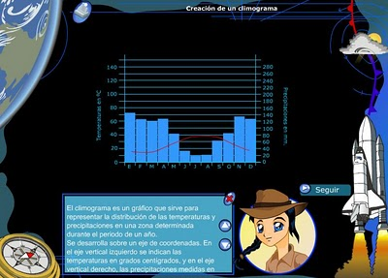
CLIMOGRAPHS
and CLIMATES

Slide 2
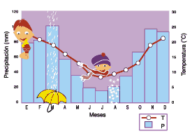
WHY CLIMOGRAPHS?
MAIN REASON
THEY HELP US TO UNDERSTAND CLIMATES QUICKER AND BETTER BY ANALSYING ITS TEMPERATURE AND PRECIPITACION
AND MOST IMPORTANTLY, THEY CAN BE USED TO INFER CONNECTIONS BETWEEN CLIMATE AND HUMAN CONDITIONS
SEVERAL
REASONS
OTHER REASONS
THEY ARE VISUAL
THEY ARE SIMPLE BUT ACCURATE
THEY HELP TO DEVELOPE HIGHER ORDER THINKING SKILLS
IT IS FUN

Slide 3
CLIMOGRAPH
DEFINITION
A CLIMOGRAPH IS A GRAPHICAL RE PRESENTATION OF BASIC CLIMATIC PARAMETERS, THAT IS MONTHLY AVERAGE TEMPERATURE AND PRECIPITATION AT A CERTAIN LOCATION.
IT IS USED FOR A QUICK-VIEW OF THE CLIMATE OF A LOCATION.
WHAT ARE OUR LEARNING OBJECTIVES?
LEARN HOW TO CONSTRUCT A CLIMOGRAPH
STUDENTS WILL…
LINK THEM TO THE MAIN LANDSCAPES
LEARN HOW TO READ AND ANALYSE CLIMOGRAPHS
UNDERSTAND THE MAIN CLIMATES OF THE WORLD
TRY TO DISCERN HOW THE CLIMATE IMPACT THE HUMAN CONDITIONS

Slide 4
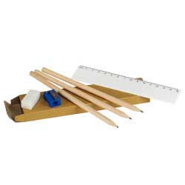
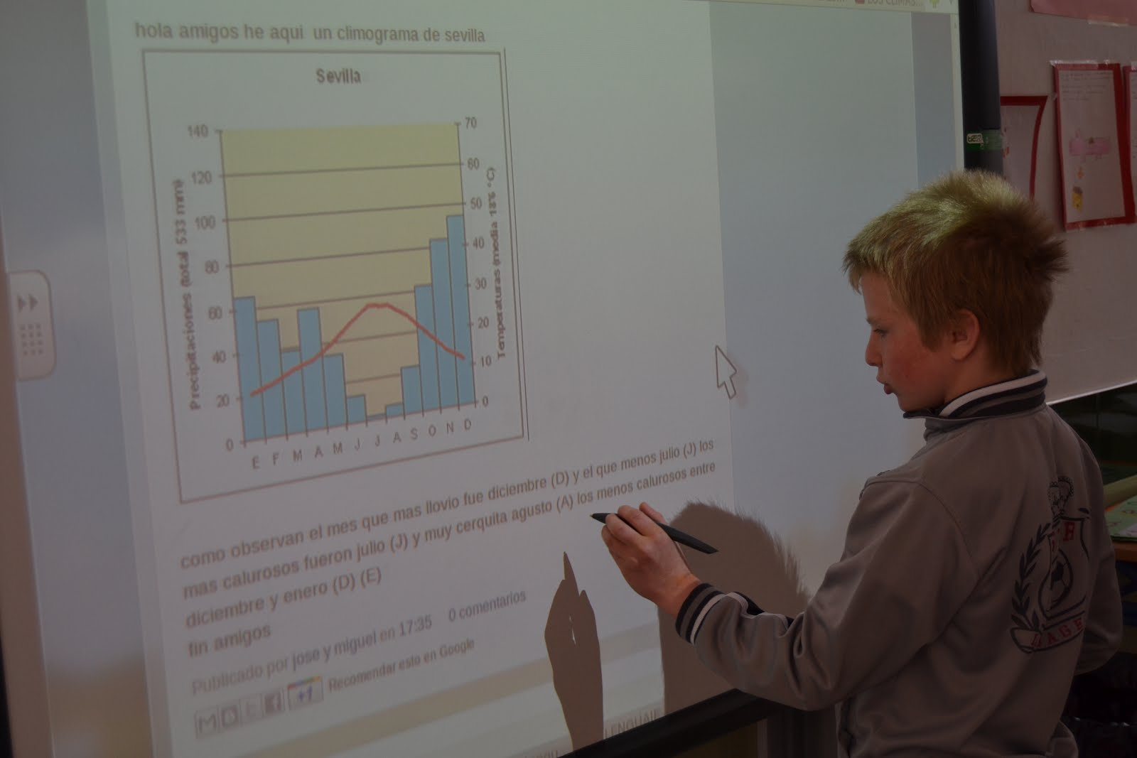
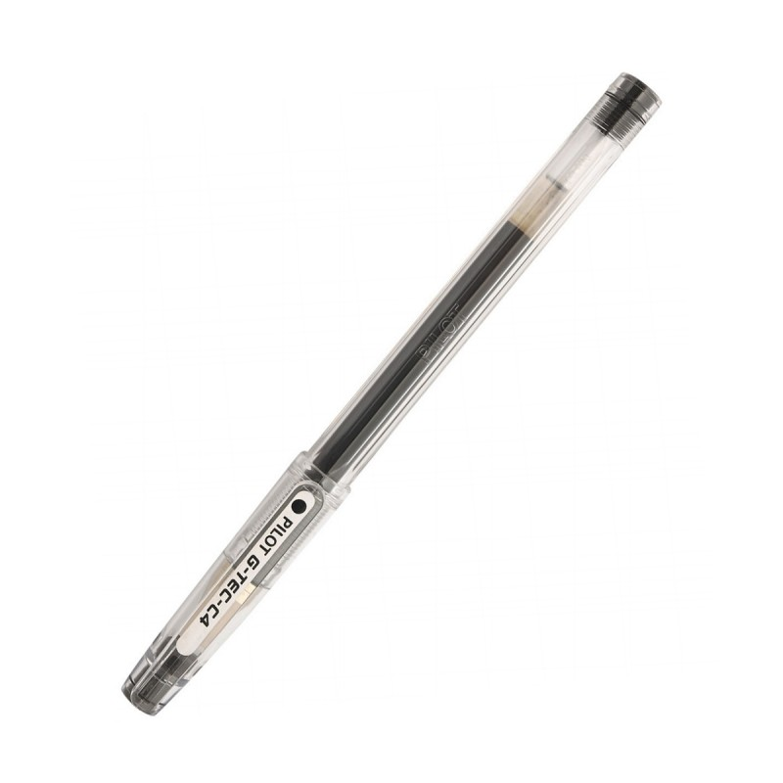
GRAPH PAPER
PENCIL, RULER, ERASER
BLACK FELT-TIP PEN
MATERIALS
COLOUR PENCILS, RED AND BLUE
AND…

Slide 5
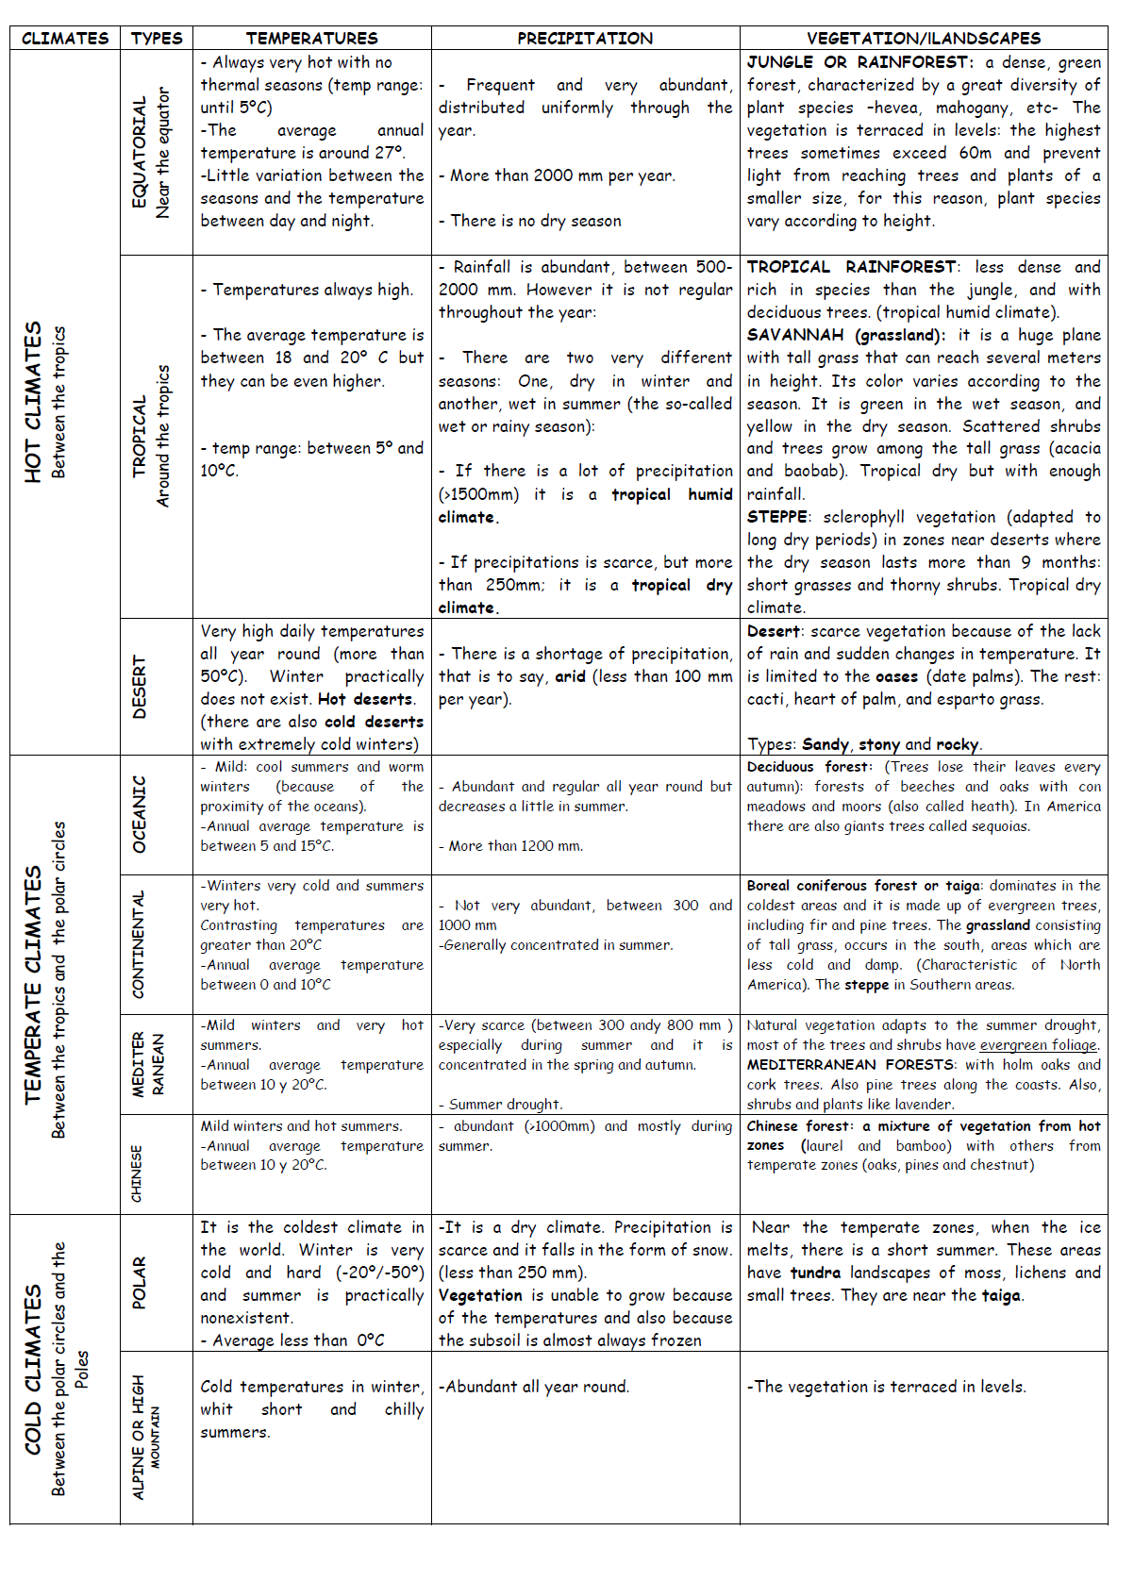
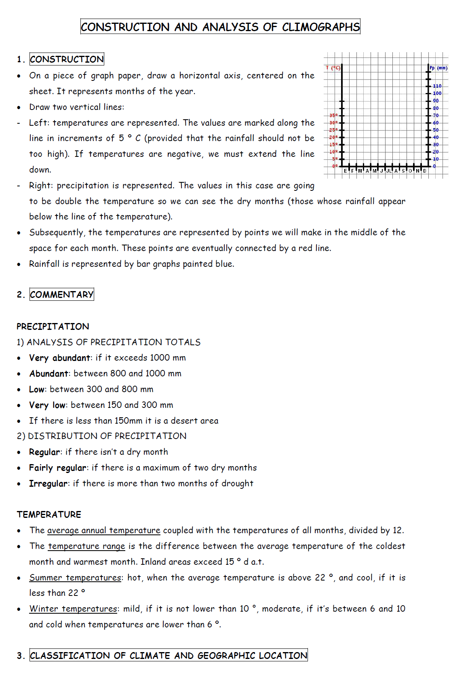
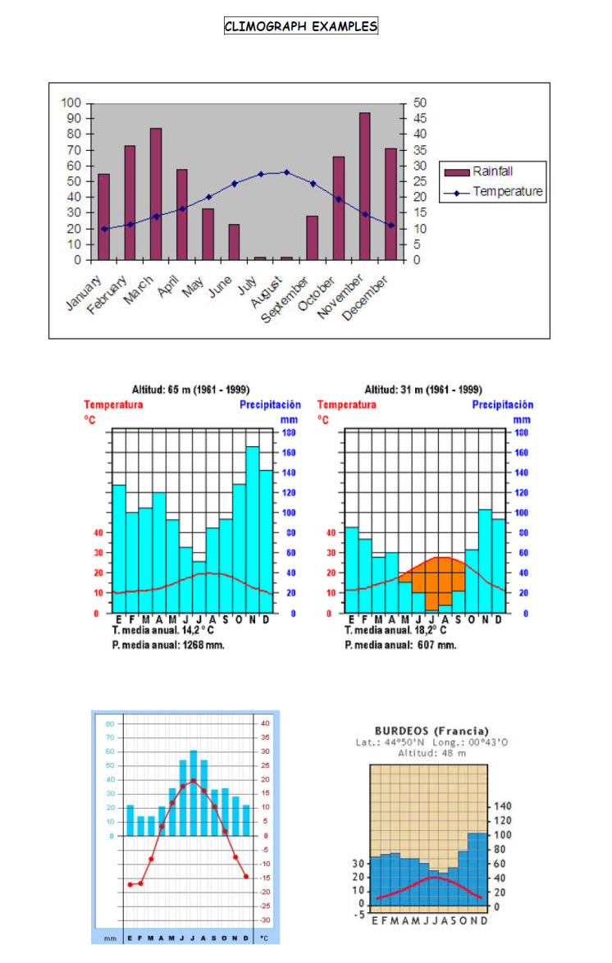
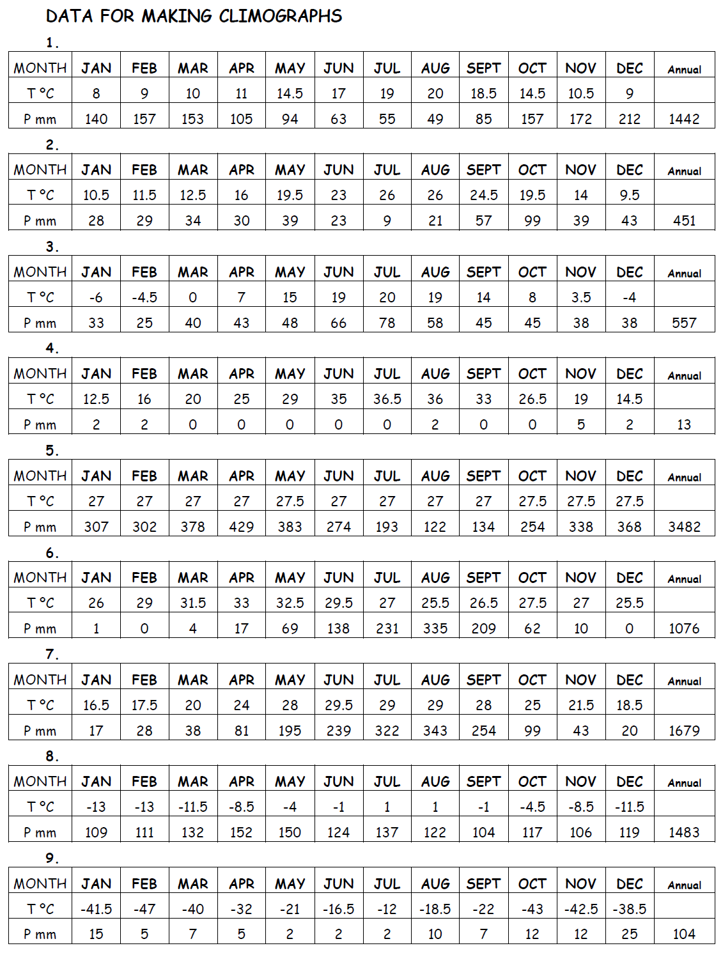
SEVERAL HANDOUTS:
DATA FOR MAKING CLIMOGRAPHS
CONSTRUCTION AND ANALYSIS OF CLIMOGRAPHS
CLIMATES OUTLINE
CLIMOGRAPHS EXAMPLES

Slide 6
OPENING QUESTION
WHAT CAN TEMPERATURE
AND PRECIPITATION INFORMATION
TELL US ABOUT
THE WAY PEOPLE LIVE IN
DIFFERENT LOCATIONS…?
4 MINUTES TO DISCUSS IN GROPUS

Slide 7
SOME POSSIBLE ANSWERS….
POPULATION DISTRIBUTION:
FERTILE AREAS AR MORE POPULATED
DESERT AREAS ARE UNINHABITED
HUMID AREAS ARE UNINHABITED
POLAR REGIONS ARE UNINHABITED
ECONOMIC DEVELOPMENT:
FERTILE AREAS ARE USALLY MORE DEVELOPED
DRY, COLD AND HUMID AREAS ARE USUALLY POORER

Slide 8
STEPS TO FOLLOW
E F M A M J JL A S O N D
1. On a piece of graph paper, draw a horizontal axis, centered on the sheet. It represents the months of the year.

Slide 9
STEPS TO FOLLOW
LEFT
Temperatures are represented. If there are negative values we must extend the line down
RIGHT
Precipitation is represented. The values in this case are going to be double the temperature
Because this is the only way to see the dry months (those whose rainfall is appear below the line of the temperature).
We will see it in a moment….
Why?
T ºC
P mm
140
MAKE SURE YOUR PRECIPITATIONS ARE DOUBLE YOUR TEMPERATURES
120
100
40
80
30
60
20
40
10
20
0
0
-10
E F M A M J JL A S O N D
P= 2T
-20
2. Draw two vertical lines. The values are marked along the line in regular increments. Depending on the amount of precipitation you decide the intervals (5 or 10 or even 20…).

Slide 10
We add the data
T ºC
P mm
140
120
100
40
80
30
60
20
40
10
20
0
0
-10
E F M A M J JL A S O N D
P= 2T
-20
We add the template of data related to that specific climograph. It is very important so we always can check the correct data.

Slide 11
We represent temperatures…
T ºC
P mm
140
120
100
40
.
.
.
80
.
.
30
.
.
.
.
.
.
.
60
20
40
10
20
0
0
-10
E F M A M J JL A S O N D
P= 2T
-20
3. Subsequently, temperatures are represented by points we will make in the middle of the space for each month. These points are eventually connected by a red line.

Slide 12
We represent precipitations…
220
P mm
T ºC
200
180
160
140
120
40
100
.
.
.
80
.
.
30
.
.
.
.
.
.
60
.
20
40
10
20
0
0
-10
E F M A M J JL A S O N D
P= 2T
-20
4. Rainfall is represented by bar graphs painted blue. The reference is the one of precipitations (right side).

Slide 13
VOCABULARY TO COMMENT…
1. VERBS
RISE, INCREASE, GROW, GO UP TO, CLIMB, BOOM, PEAK, FALL, DECLINE, DECREASE, DROP, GO DOWN, REDUCE
REMAIN STABLE, REMAIN STEADY, STAY CONSTANT, NO CHANGE, MANTAIN THE SAME LEVEL,
CRASH, COLLAPSE
2. ADJECTIVES
SHARP, RAPID, HUGE, DRAMATIC, SUBSTANTIAL, CONSIDERABLE, SIGNIFICANT, SLIGHT, SMALL, MINIMAL, MASSIVE
3. ADVERBS
GENTLY, GRADUALLY , SHARPLY, RAPIDLY, DRAMATICALLY , SUBSTANTIALLY, CONSIDERABLY, SIGNIFICANTLY, SLIGHTLY, MODERATELLY

Slide 14
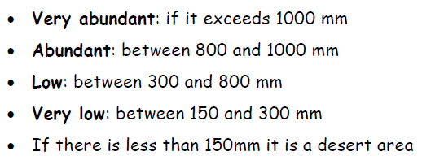
COMMENTARY…
PRECIPITATION, ANALYSIS
1. PRECIPITATION, TOTALS
2. DISTRIBUTION OF PRECIPITATION

Slide 15
ANALYSIS OF TEMPERATURE

Slide 16
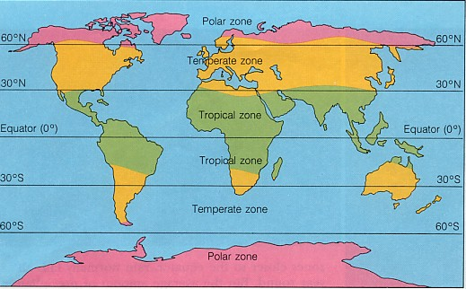
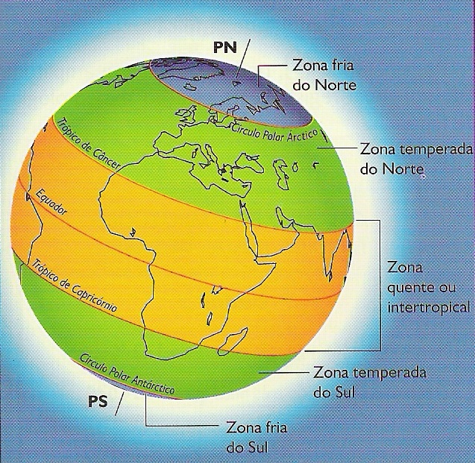
CLIMATE ZONES
TEMPERATE CLIMATES
The temperate zones are between the tropical zone and the polar zone in both hemispheres.
Temperate zones have four seasons: the more extreme winter and summer seasons, and the milder spring and autumn seasons.
We can identify three different types of climate in the temperate zones:
Oceanic
Mediterranean
Continental
COLD CLIMATES
The cold zones include the area around the poles, and also areas above an altitude of 2500 metres. There are two types:
Polar
Mountain
HOT CLIMATES
These climates are found between the Tropic of Cancer and the Tropic of Capricorn, where the Sun´s rays reach the Earth´s surface at a direct angle. Average temperatures are high (over 18ºC), and there is no winter. There are three types of hot climates:
Equatorial
Tropical
Desert (hot dessert and steppe)

Slide 17
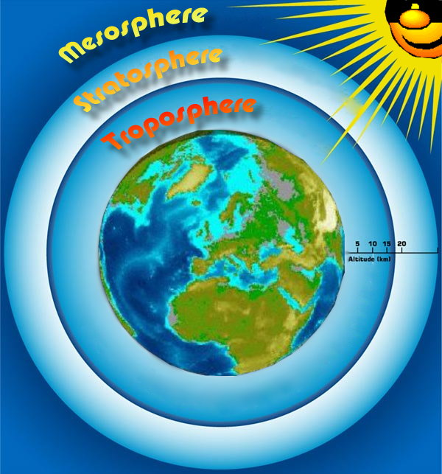
Any questions?

