Slide 1
MIND MAPS

Slide 2
What is a mind map?
A mind map is a special kind of brain-friendly diagram that helps you to think, imagine, remember things, and plan and sort information –in short, it´s a perfect tool to help you do your revision.

Slide 3
What is a mind map for?
SORT OUT
Information and ideas
BE
CREATIVE
use your IMAGINATION
REMEMBER
CONCENTRATE
UNDERSTAND
STAY COOL
STAY INTERESTED
TAKE NOTES
TAKE CONTROL

Slide 5
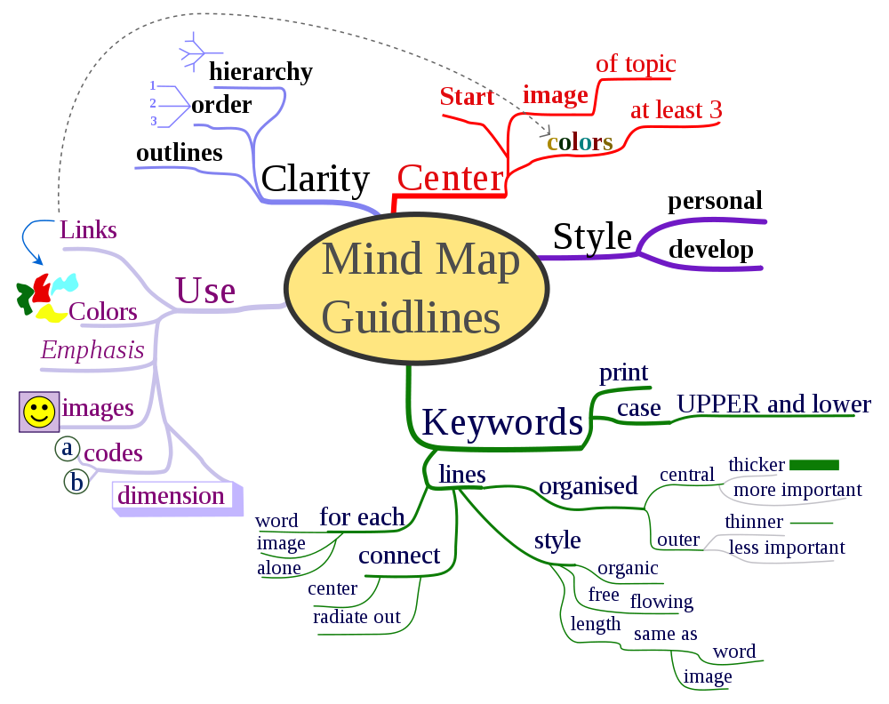
Steps to follow?
Put your central idea, topic or image in the centre
Put your main ideas or topics on the main branches
Put your sub-ideas or topics on the secondary branches
Put your sub-sub-ideas or topics on the little branches

Slide 6
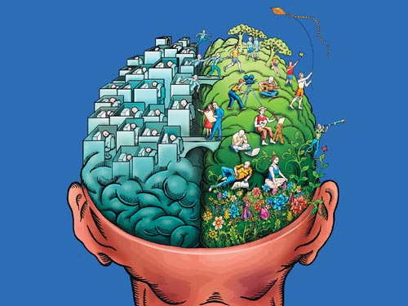
TOOLS REQUIRED
PLAIN WHITE PAPER
FELT-TIP PENS
YOUR BRAIN !!!

Slide 8
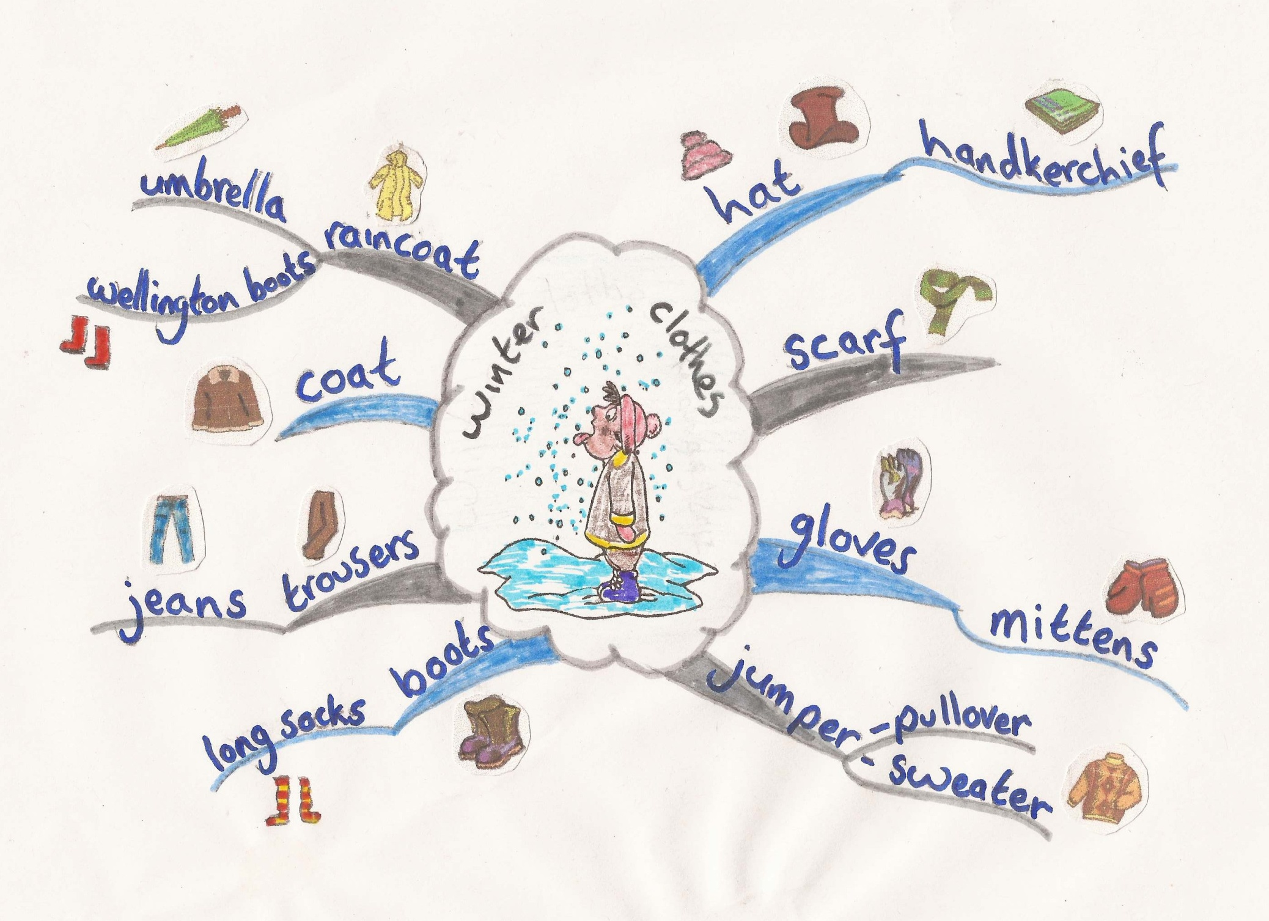

Slide 9
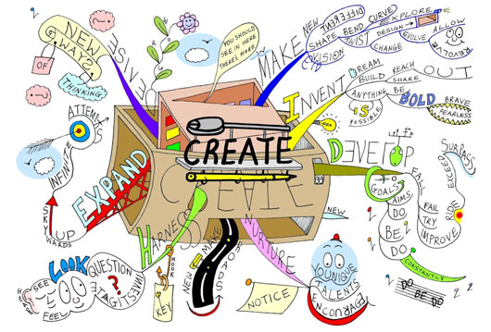

Slide 10
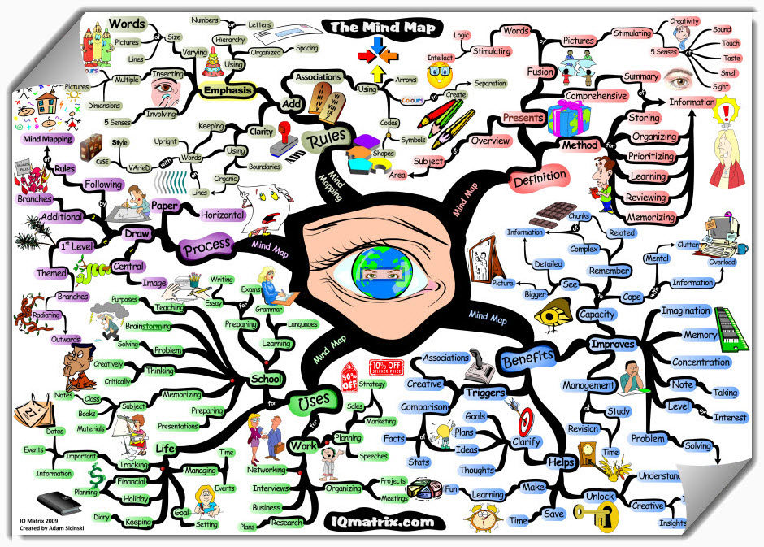

Slide 11
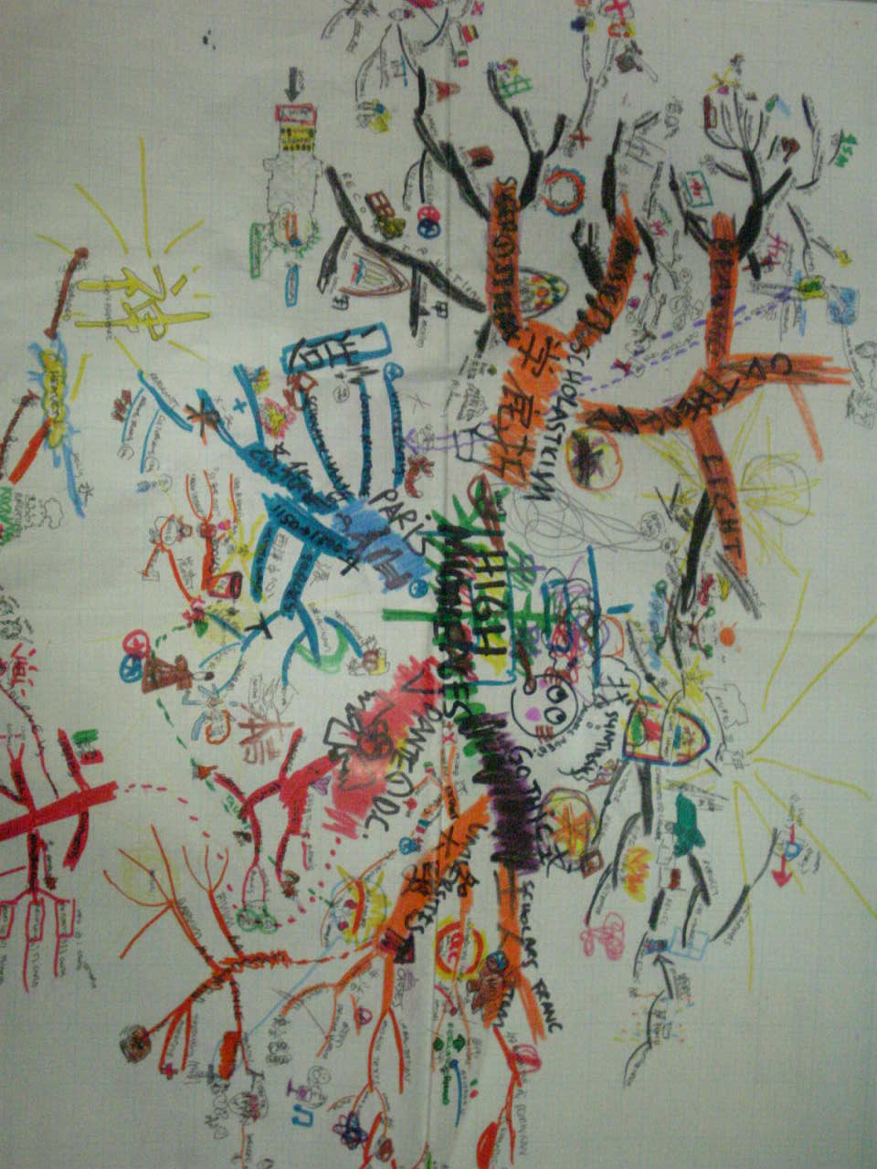

Slide 12
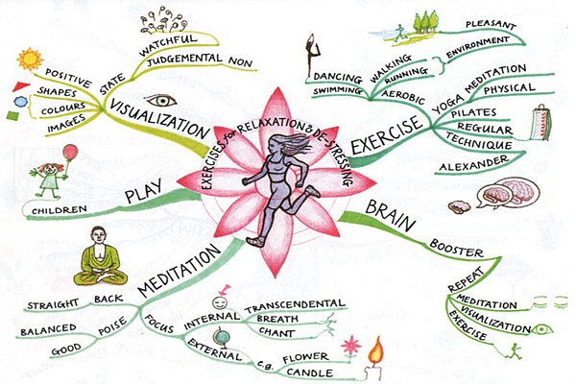

Slide 13
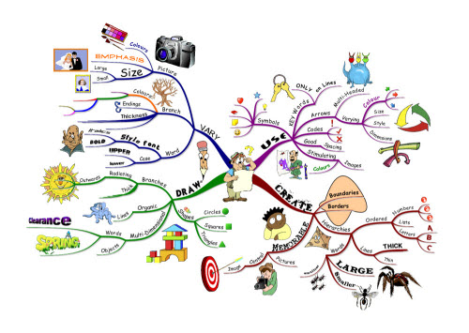

Slide 14
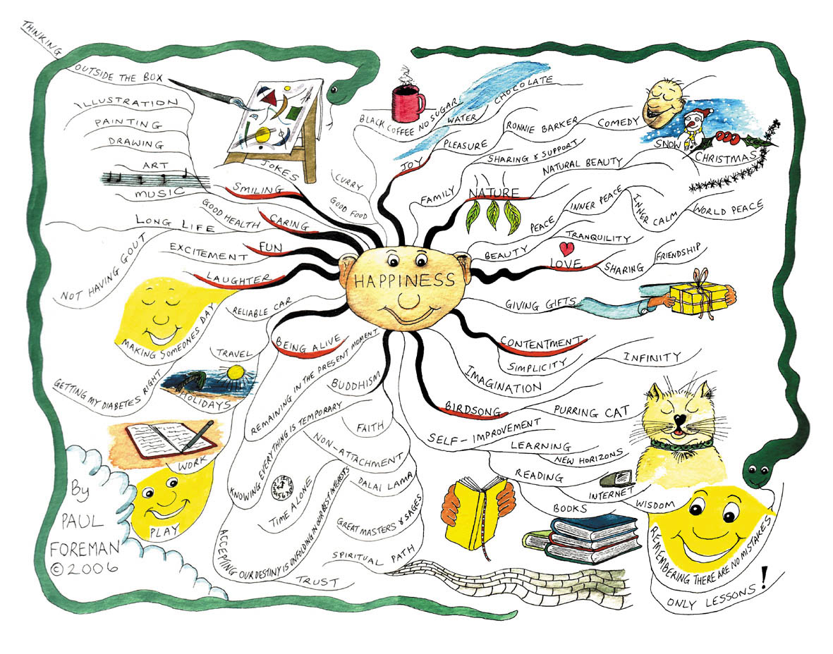

Slide 15
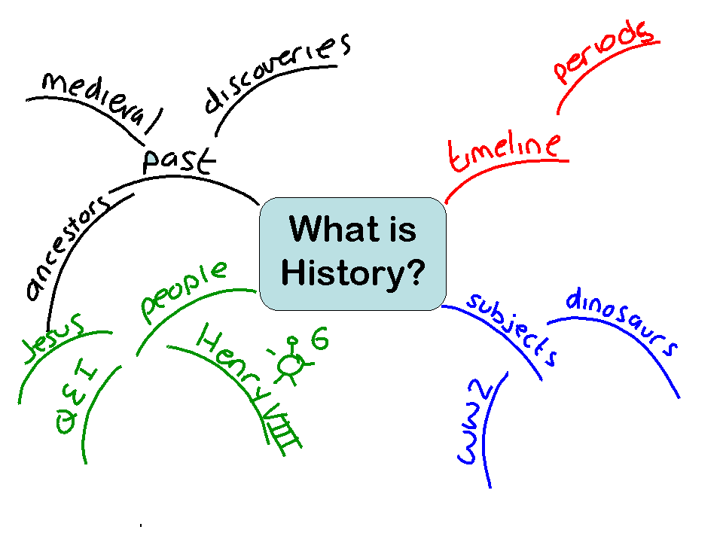

Slide 16
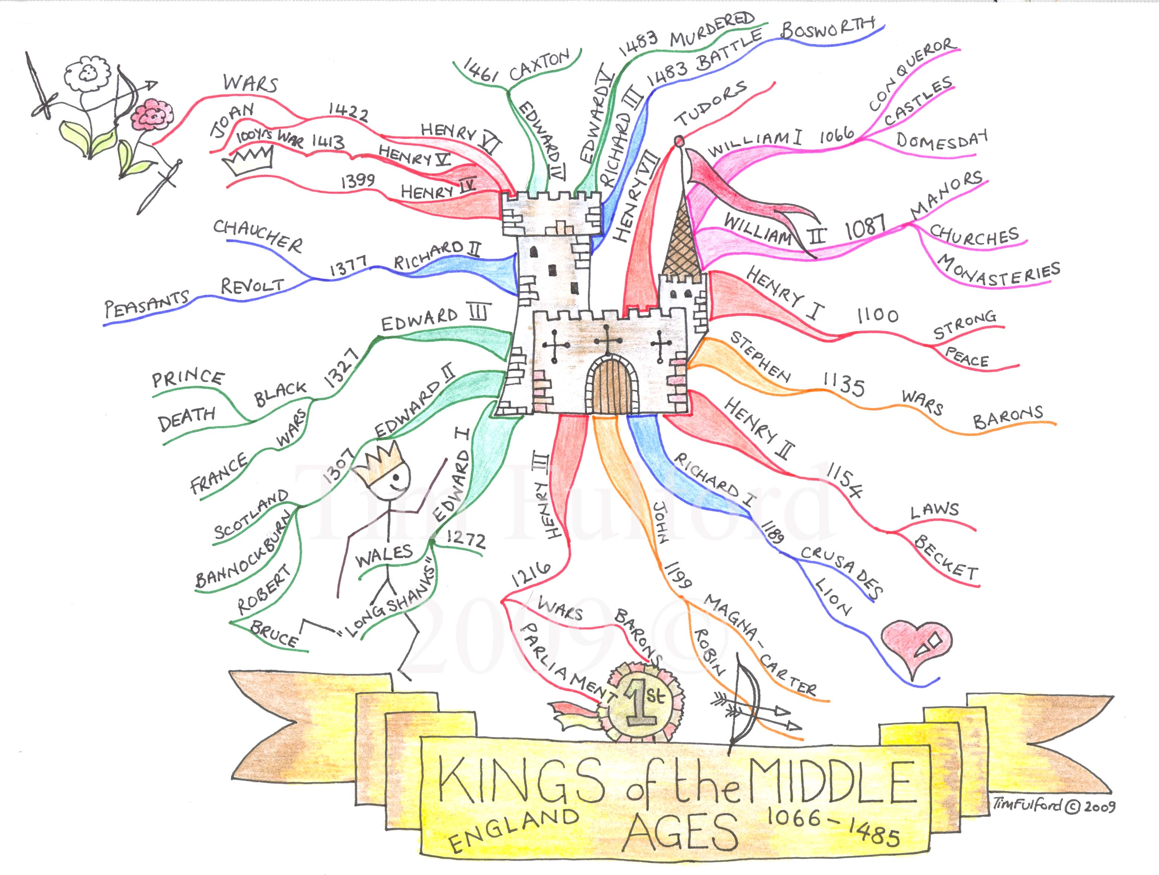

Slide 18
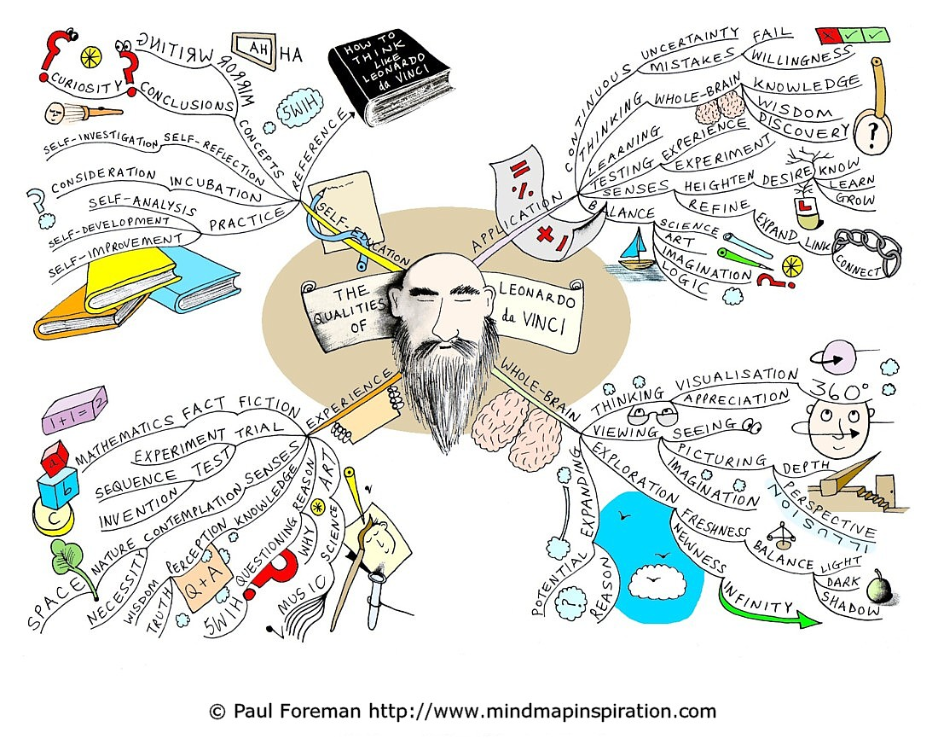

Slide 19
