Slide 1
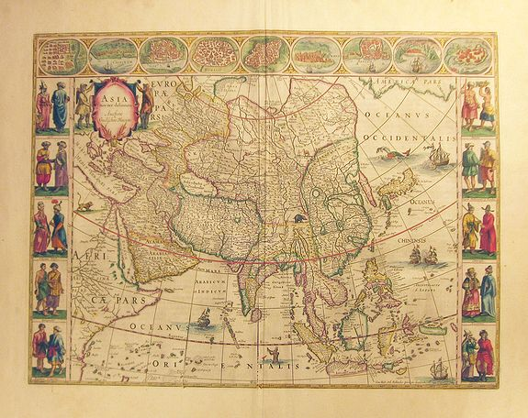
PHISICAL ASIA

Slide 2
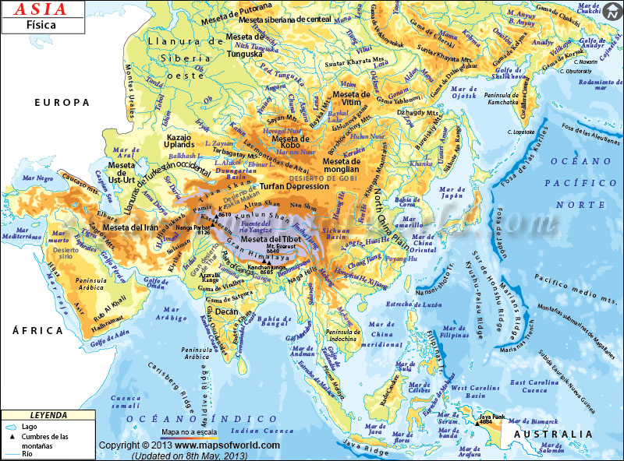
IT IS THE LARGEST CONTINENT, WITH A SURFACE AREA OF 44,9 MILLION KM2
MOUNT EVEREST IS THE HIGHEST MOUNTAIN AND DEAD SEA THE LOWEST AREA IN THE WORLD

Slide 3
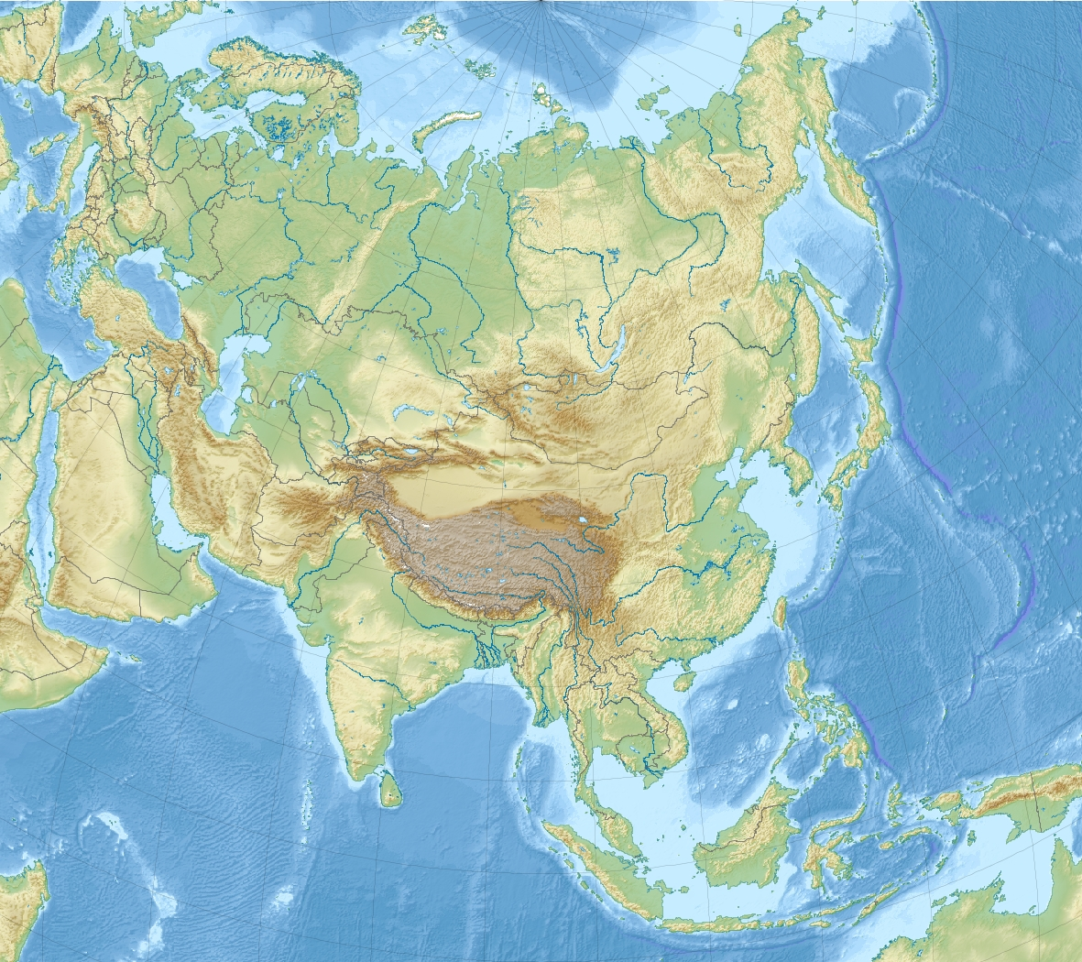
KOLIMA
VERHOYANSK
URAL MOUNTAINS
STANOVY
CAUCASUS
ALTAY
ZAGROS
TIEN SHAN
HINDU
KUSH
KUN LUN
HIMALAYAS
(EVEREST)
RELIEF: MOUNTAINS

Slide 4
CENTRAL SIBERIAN
IRANIAN
PAMIR
TIBETAN
DECCAN
RELIEF: PLATEAUS

Slide 5
WEST SIBERIAN
PLAIN
CASPIAN DEPRESSION
DEAD SEA DEPRESSION
ARAL
SEA D.
GOBI
TAKLA MAKAN
ARABIAN
RELIEF: PLAINS, DEPRESSIONS AND DESERTS

Slide 6
SEA OF
OKHOTSK
CASPIAN
ARAL
SEA
DEAD
SEA
SEA OF JAPAN
YELLOW
SEA
ARABIAN
SEA
SOUTH CHINA
SEA
SEAS

Slide 7
KAMCHATKA
ANATOLIAN
KOREAN
ARABIAN
INDIAN
INDOCHINESE
MALAY
PENINSULAS

Slide 8
STRAIT OF BERING
PERSIAN
OMAN
TONKIN
BAY OF BENGAL
THAILAND
(SIAM)
GULFS AND STRAITS

Slide 9
SAKHALIN
JAPANESE A.
TAIWAN
(FORMOSA)
HAINAN
SRI LANKA
(CEILAN)
PHILIPPINE A.
MOLUCCA
BORNEO
SUMATRA
ISLANDS
JAVA

Slide 10
LENA
OB
YENISEY
LAKE
BAIKAL
AMUR
LAKE BALJASH
TIGRIS
SYR DARYA
EUPHRATES
AMUR DARYA
HUANG-HE
(YELLOW)
INDUS
YANGTZE
(BLUE)
GANGES
BRAHMAPUTRA
MEKONG
RIVERS AND LAKES

Slide 11
