Slide 1
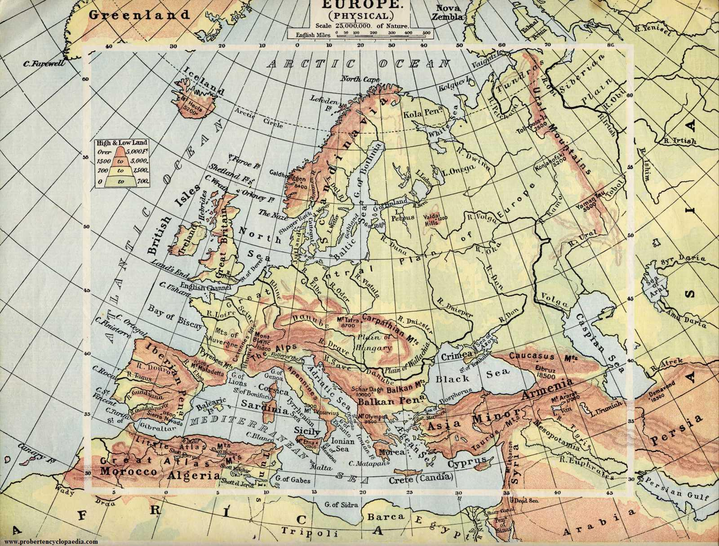
PHYSICAL EUROPE

Slide 2
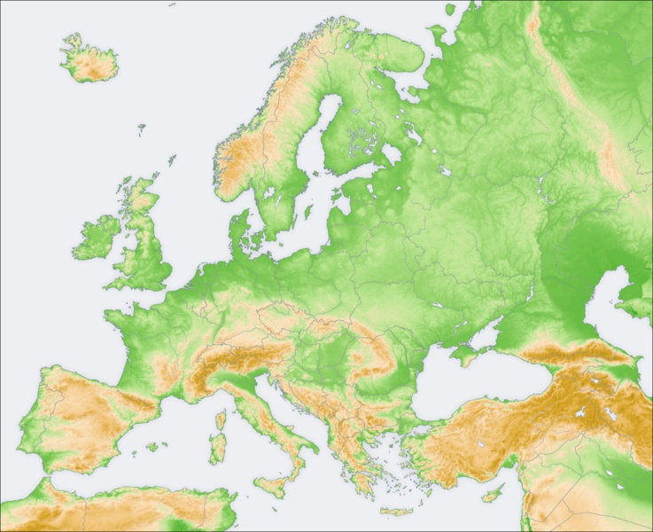
URAL MOUNTAINS
KJOLEN MOUNTAINS
RELIEF: OLD MOUNTAIN RANGES
ARDENNES
CENTRAL
MASSIF

Slide 3
URAL MOUNTAINS
KJOLEN MOUNTAINS
EUROPEAN PLAIN
RELIEF: YOUNG MOUNTAIN RANGES
ARDENNES
CARPATHIAN
CENTRAL
MASSIF
ALPS
CAUCASUS
PYRENEES
DINARIC ALPS
APENNINES
BALKANS
BETIC CHAIN

Slide 4
BARENTS
SEA
NORWEGIAN
SEA
BALTIC SEA
NORTH
SEA
SEAS
SEA OF AZOV
CASPIAN SEA
CANTABRIAN SEA
BLACK SEA
LIGURIAN
ADRIATIC
MARMARA
TYRRHENIAN
AEGEAN
IONIAN

Slide 5
KOLA
ESCANDINAVIAN
JUTLANDIA
PENINSULAS
CRIMEA
IBERIAN
PENINSULA
ITALIAN PENINSULA
BALKAN P.

Slide 6
BOTHNIA
FINLAND
GULFS
BAY OF
BISCAY
VENICE
LYON
GENOA
VALENCIA

Slide 7
NORTH CAPE
CAPES
SAINT-MATHIEU
POINT
FINISTERRE
ROCA
CREUS
SAINT
VICENT
GATA
SPARTIVENTO
TARIFA
MATAPAN

Slide 8
STRAITS
ENGLISH
CHANNEL
BOSPHORUS
BONIFACIO
DARDANELLES
GIBRALTAR
MESSINA

Slide 9
ICELAND
BRITAIN
BRITISH
ISLES
IRELAND
ISLANDS
CORSICA
BALEARIC
ISLANDS
SARDINIA
SICILY
CYPRUS
MALTA
CRETE

Slide 10
PECHORA
DVINA
ONEGA
LADOGA
DAUGAVA
URAL
VISTULA
RIVERS AND LAKES
THAMES
ELBE
ODER
DON
VOLGA
RHINE
SEINE
DNIEPER
DNIESTER
LOIRE
RHONE
PO
DA NUBE
EBRO
TAGUS

Slide 11
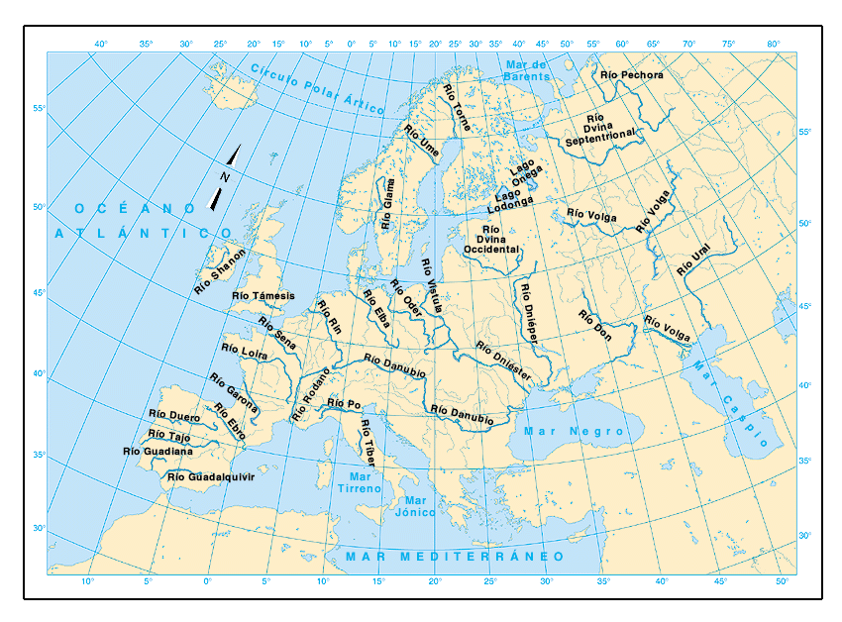

Slide 12
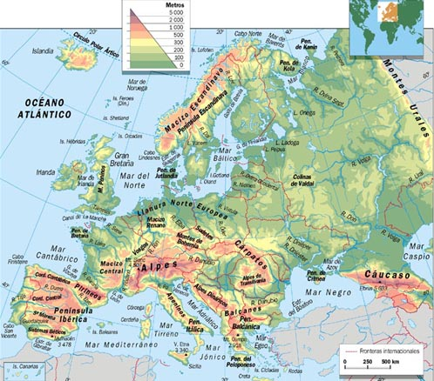

Slide 13
