Slide 1
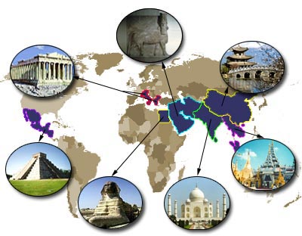
UNIT 10
EGYPT

Slide 2
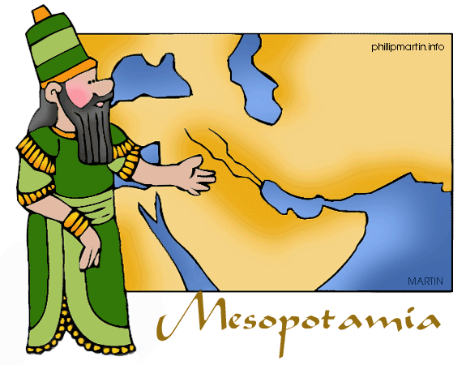
IN THIS UNIT YOU WILL…
Learn where early civilisations developed
Understand the importance of riveres in early civilisations
Learn about the political organisation of Ancient Egypt and Mesopotamia
Learn about the society and culture of early civilisations

Slide 3
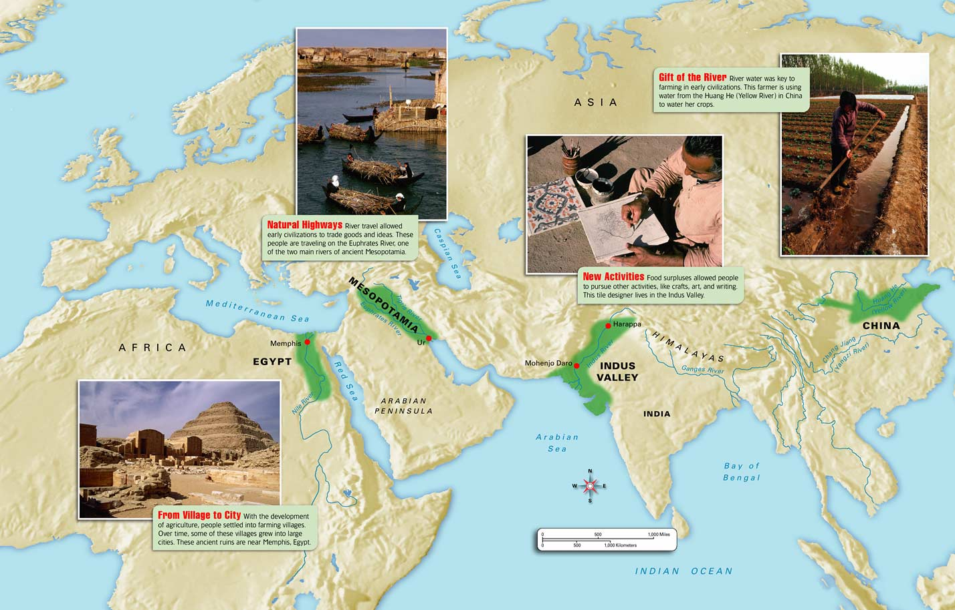
RIVER CIVILISATIONS
MESOPOTAMIA WAS LIKE OTHER PARTS OF THE WORLD, SUCH AS EGYPT, INDIA AND CHINA AN AREA IN WHICH THE FLOODING OF GREAT RIVERS FERTILISED THE LAND AND AGRICULTURE DEVELOPED. AS A RESULT SMALL SETTLEMENTS GREW INTO CITIES

Slide 4
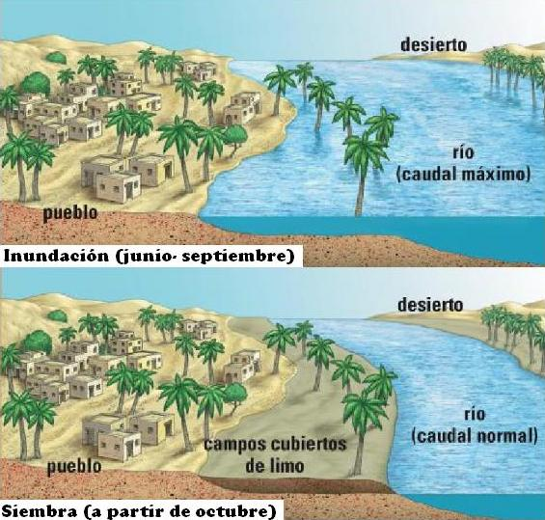
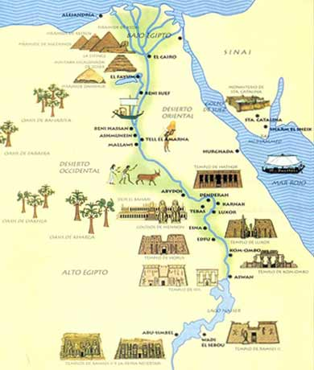
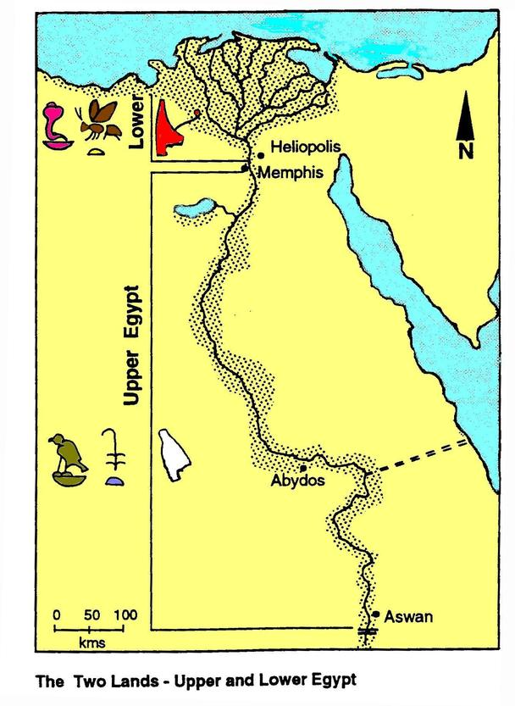
ANCIENT EGYPT
ENVIRONMENT AND HISTORY
ANCIENT EGYPTIAN CIVILISATION DEVELOPED AFTER 4000 BC ALONG THE BANKS OF THE NILE RIVER
AS A RESULT, THE RIVER WAS SO IMPORTANT THAT THE EGYPTIANS WORSHIPPED IT LIKE A GOD.
THE NILE FLOODED THE RIVER VALLEY EACH SUMMER AND FERTILISED ITS LAND
BOATS COULD NAVIGATE ALONG SO IT WAS ALSO A TRADE AND COMMUNICATION ROUTE.
THERE WERE TWO REGIONS

Slide 5
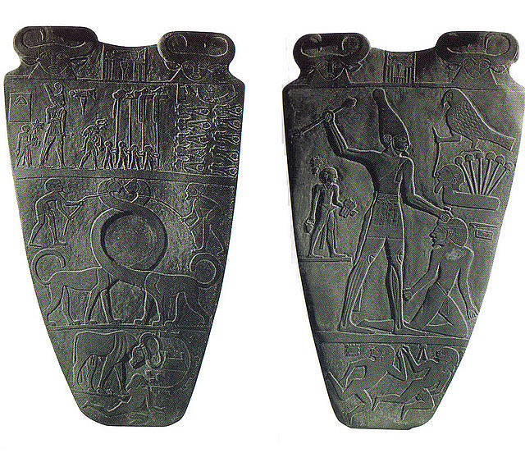
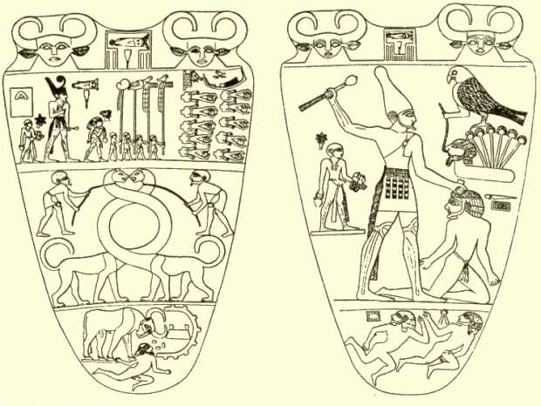
THE HISTORY OF EGYPT
INDEPENDENT KINGDOMS DEVELOPED IN UPPER EGYPT AND LOWER EGYPT UNTIL THEY WERE UNITED AROUND 3100 BC
THIS WAS THE BEGINNING OF A CIVILISATION THAT LASTED MORE THAN 3000 YEARS

Slide 6
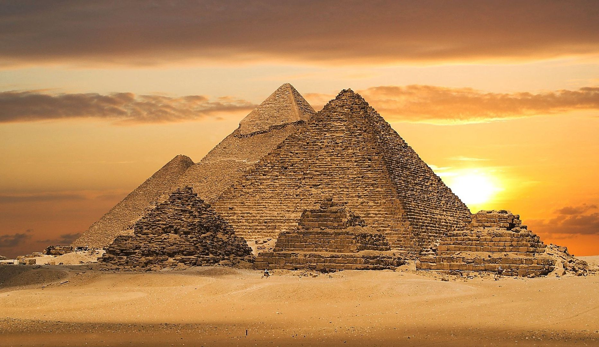
THE HISTORY OF EGYPT
OLD KINGKDOM
(2700-2200BC)
NEW KINGDOM
LATE PERIOD
MIDDLE KINGDOM
THERE WERE FOUR MAIN PERIODS
THE KINGS, OR PHARAOHS, RULED ALL EGYPT FROM THEIR CAPITAL MENPHIS. THE GREAT PYRMIDS OF GIZA WERE BUILT

Slide 7
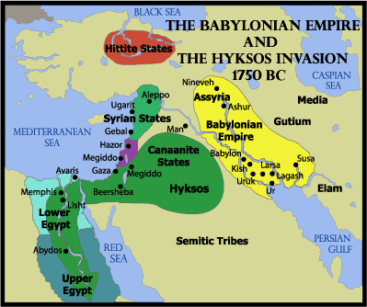
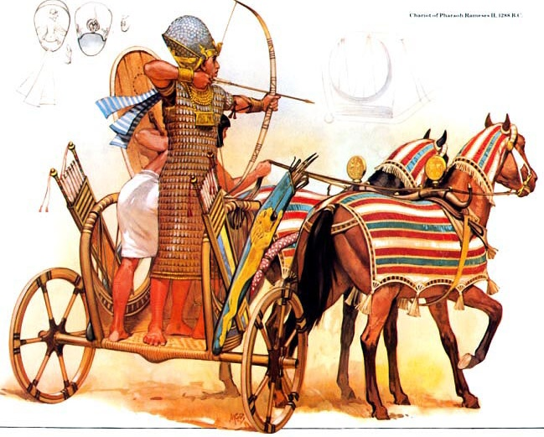
THE HISTORY OF EGYPT
OLD KINGKDOM
(2700-2200BC)
NEW KINGDOM
LATE PERIOD
MIDDLE KINGDOM
(2050-1650 BC)
THERE WERE FOUR MAIN PERIODS
THERE WAS TERRITORIAL EXPANSION, AND THE CAPITAL WAS REMOVED TO THEBES. EGYPT WAS INVADED BY THE HYCSOS, PEOPLE FROM MESOPOTAMIA

Slide 8
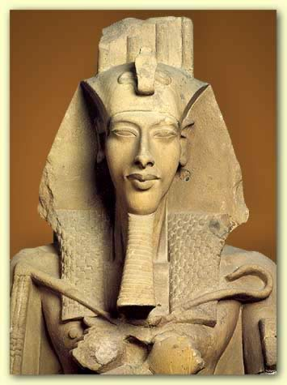
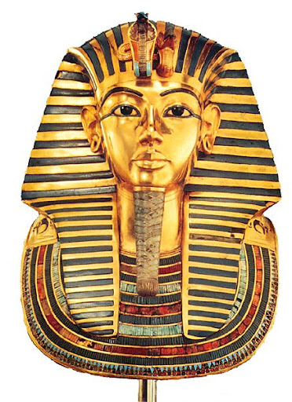
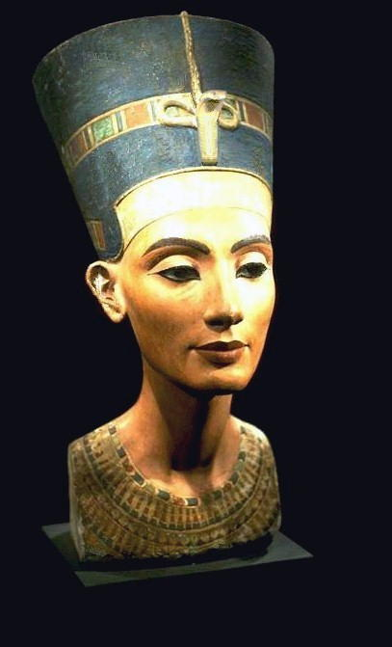
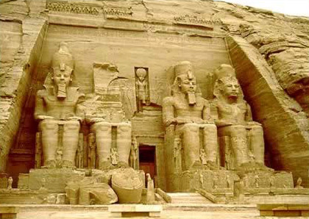
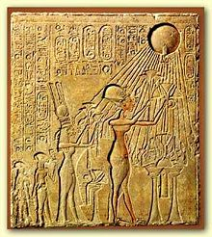
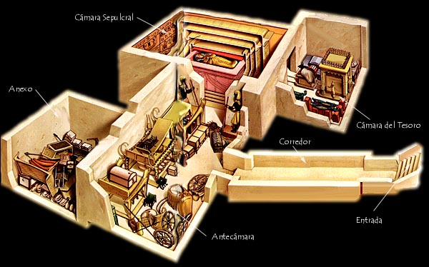
THE HISTORY OF EGYPT
OLD KINGKDOM
(2700-2200BC)
NEW KINGDOM
(1550-1070BC)
LATE PERIOD
MIDDLE KINGDOM
(2050-1650 BC)
THERE WERE FOUR MAIN PERIODS
EXPANSION CARRIED OUT BY THE PHARAOH AHMOSE I CONTINUED TOWARDS LYBIA AND SYRIA. FAMOUS PHARAOHS INCLUDED AKHENATEN, TUTANHAMUN AND RAMESSES II

Slide 9
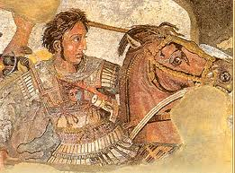
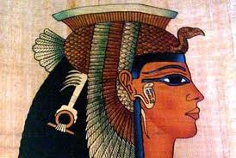
THE HISTORY OF EGYPT
OLD KINGKDOM
(2700-2200BC)
NEW KINGDOM
LATE PERIOD
(700-300 AC)
MIDDLE KINGDOM
(2050-1650 BC)
THERE WERE FOUR MAIN PERIODS
EGYPT BROKE UP INTO SMALL INDEPENDENT STATES. IT WAS CONQUERED SEVERAL TIMES. IN 4TH BC IT WAS CONQUERED BY ALEXANDER THE GREAT AND FINALLY IN 30 BC IT BECAME PART OF THE ROMAN EMPIRE

Slide 10
ANCIENT EGYPT: SOCIETY
HIERARCHICAL
SOCIETY
PHARAOH
SLAVES
FARMERS
ARTISANS
SOLDIERS
MERCHANTS
GOVERNORS / OFFICIALS
SCRIBES
PRIESTS
NOBLEMEN
THE RULING ELITE
INTERMEDIATE GROUPS
FREE SOCIETY
LOWER LEVEL
WOMEN
BASE

Slide 11
ANCIENT EGYPT: SOCIETY
HIERARCHICAL
SOCIETY
Label the different social class
THE RULING ELITE
INTERMEDIATE GROUPS
LOWER LEVEL
BASE

Slide 12
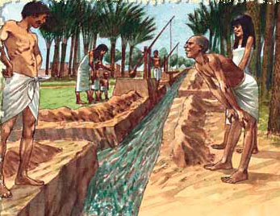
ANCIENT EGYPT: ECONOMY
IRRIGATED AGRICULTURE
THE EGYTIANS GREW CEREALS TO MAKE BREAD AND BEER. THEY ALSO GREW VINES, OLIVES, VEGETABLES AND FLAX TO MAKE CLOTHES. WATER FROM NILE WAS DISTRIBUTED THROUGH CANALS, DAMS AND IRRIGATION SYSTEMS

Slide 13
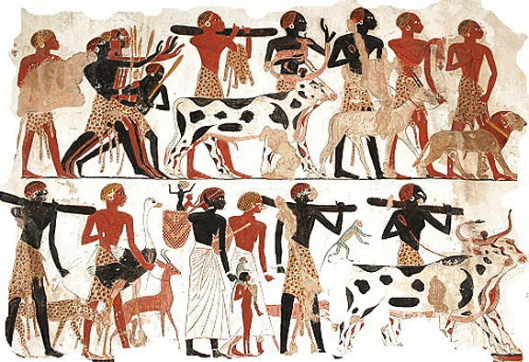
ANCIENT EGYPT: ECONOMY
LIVESTOCK
THEY KEPT COWS, PIGS, SHEEP, CHIKENS AND DONKEYS

Slide 14
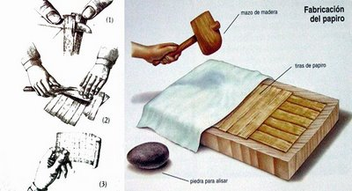
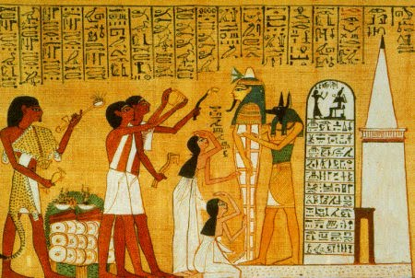
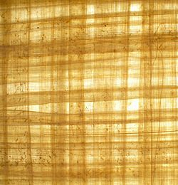
ANCIENT EGYPT: ECONOMY
CRAFTS
THEY PRODUCED TEXTILES, POTTERY AND JEWELLERY IN SMALL WORKSHOPS. THEY USED PAPYRUS TO CREATE WRITING PAPER

Slide 15
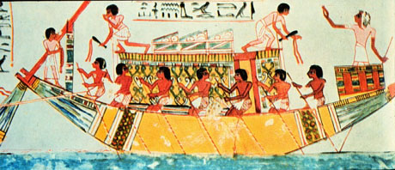
ANCIENT EGYPT: ECONOMY
TRADE
LOCAL PRODUCTS WERE EXCHANGED ALONG THE NILE. THEY EXPORTED CEREALS, POTTERY AND PAPYRUS TO MESOPOTAMIA AND GREECE, AND IMPORTED METALS AND LUXURY GOODS

Slide 16
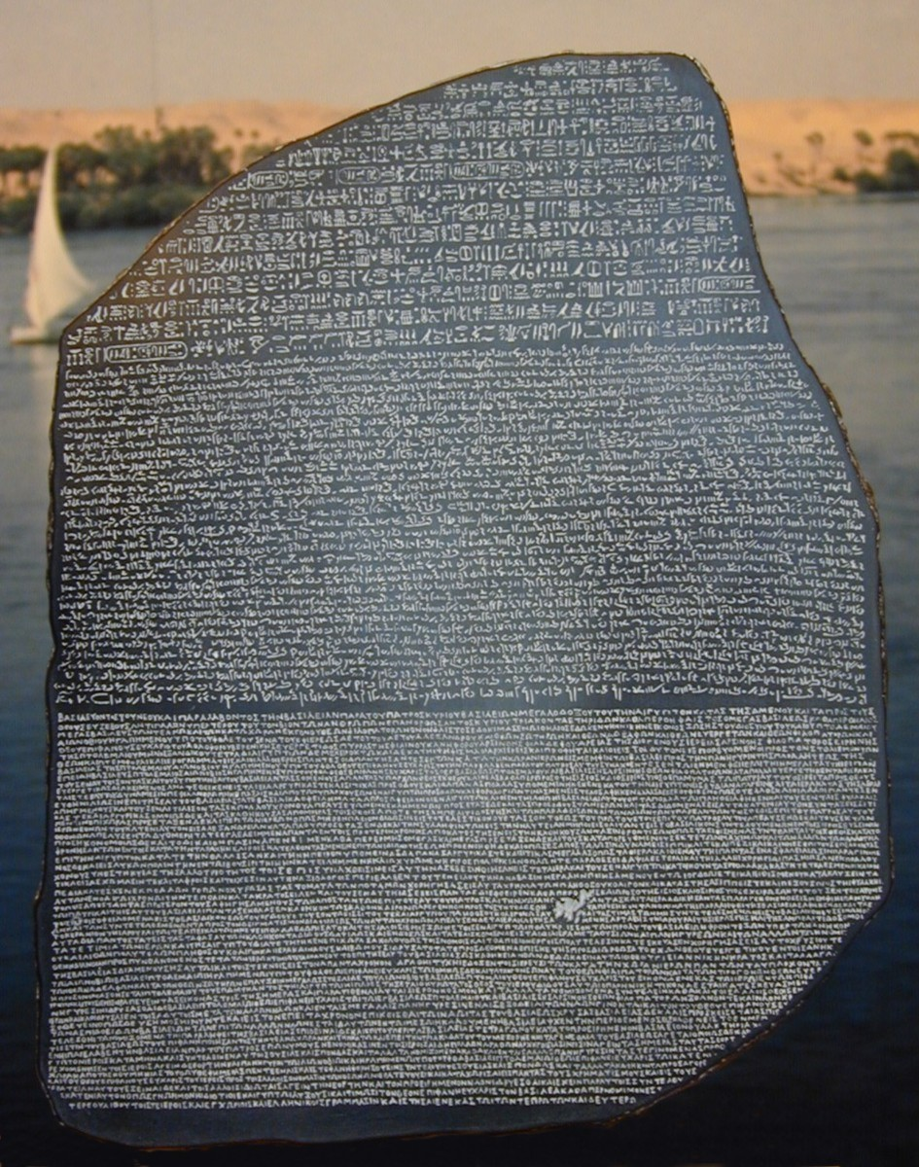
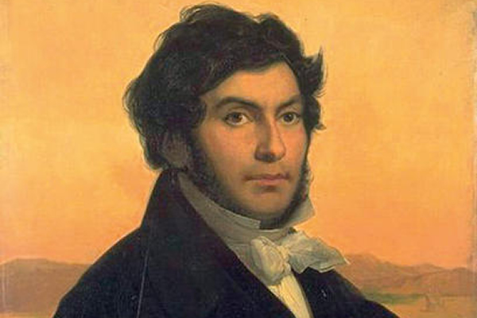
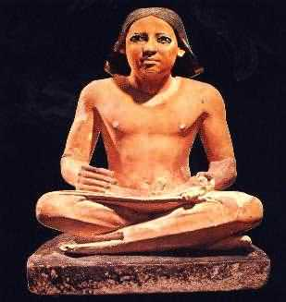
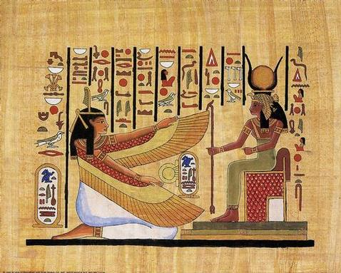
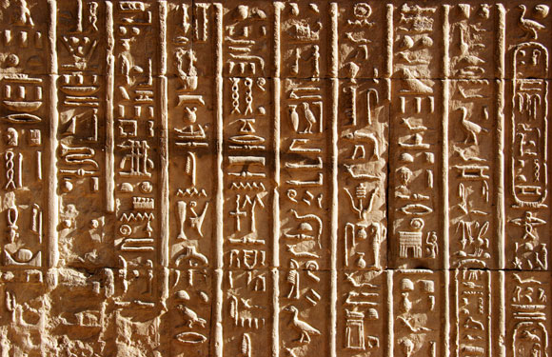
ANCIENT EGYPT: CULTURE
WRITING
THE ANCIENT EGYPTIANS INVENTED WRITING AT THE SAME TIME AS THE MESOPOTAMIANS
THEY USED HIEROGLYPHS, WHICH WERE SYMBOLS AND PICTURES THAT REPRESENTED OBJECTS AND IDEAS
THE ROSETTA STONE WAS DISCOVERED IN EGYPT IN 1799. IT HAD THE SAME INSCRIPTION IN HIEROGLYPHICS, LOCAL WRITING AND GREEK. JEAN-FRANCOIS CHAMPOLLION STARTARTED THE INTERPRETATION OF THIS WRITING.
THE MISTERY OF THE ROSETTA STONE (1/8). 6:57. IT MUST BE CONTINUED WITH THE FOLLOWING… (FILM…?)
HISTORY CHANNEL-ANCIENT EGYPT O2of10Rosetta Stone.HD
(46:11). A long documentary about the discover.

Slide 17
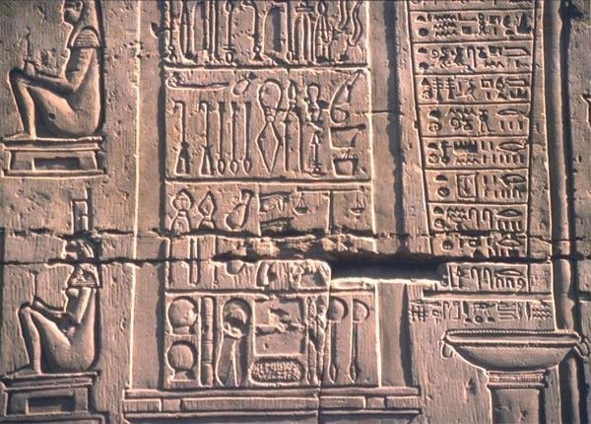
ANCIENT EGYPT: CULTURE
ASTRONOMY
MEDICINE
THEY USED ASTRONOMY TO STUDY THE FLOODING OF THE NILE. THEY INVENTED THE SOLAR CALENDAR
THEY LEARNED A GREAT DEAL ABOUT THE HUMAN BODY AND EVEN PRACTISED SURGERY
MATHEMATICS
THEY USED MATHEMATICS TO CALCULATE THE LEVEL OF WATER IN THE NILE

Slide 18
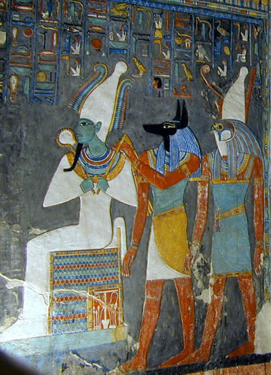
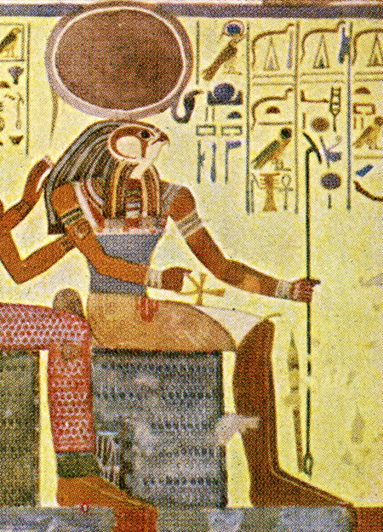
ANCIENT EGYPT: RELIGION
THE ANCIENT EGYPTIANS WERE POLYTHEISTS, WHO BELIEVED IN MANY GODS. EACH CITY HAD ITS OWN DIVINITY, AND EGYPTIANS ALSO WHORSIPPED THE PHARAOH AND THE NILE
GOD OF THE SUN
GOD OF TH SKY AND WAR
THE ANCIENT EGYPTIANS BELIEVED IN LIFE AFTER DEATH. THE DEAD WERE MUMMIFIED SO THAT THEY WOULD HAVE A BODY IN THE AFTERLIFE
RA
HORUS
GOD OF THE DEAD
GUARDIAN OF THE DEAD
OSIRIS
ANUBIS
Enter the embalmer's workshop, where you are to prepare the body of Ramose, officer to the king, for burial.The chief embalmer, Kha, will be watching your work closely.
GOD OF THE WIND
GODDESSES OF FERTILITY
ISIS
AMUN
A monographic presentation about mummies and pyramids made by me…

Slide 19
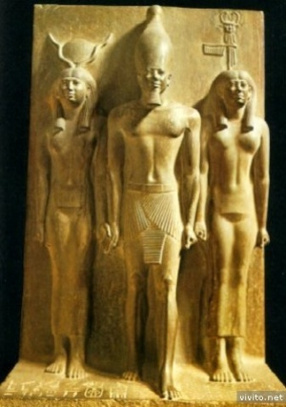
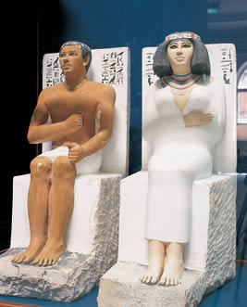
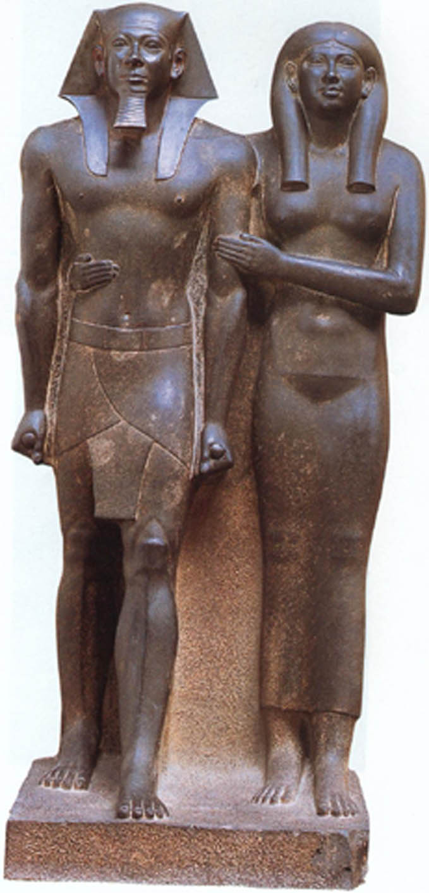
EGYPT: ART
SCULPTURE
THE MAIN SUBJECTS WERE PHARAOS AND GODS. THE SCULPTURES WERE RIGID AND EXPRESSIONLESS

Slide 20
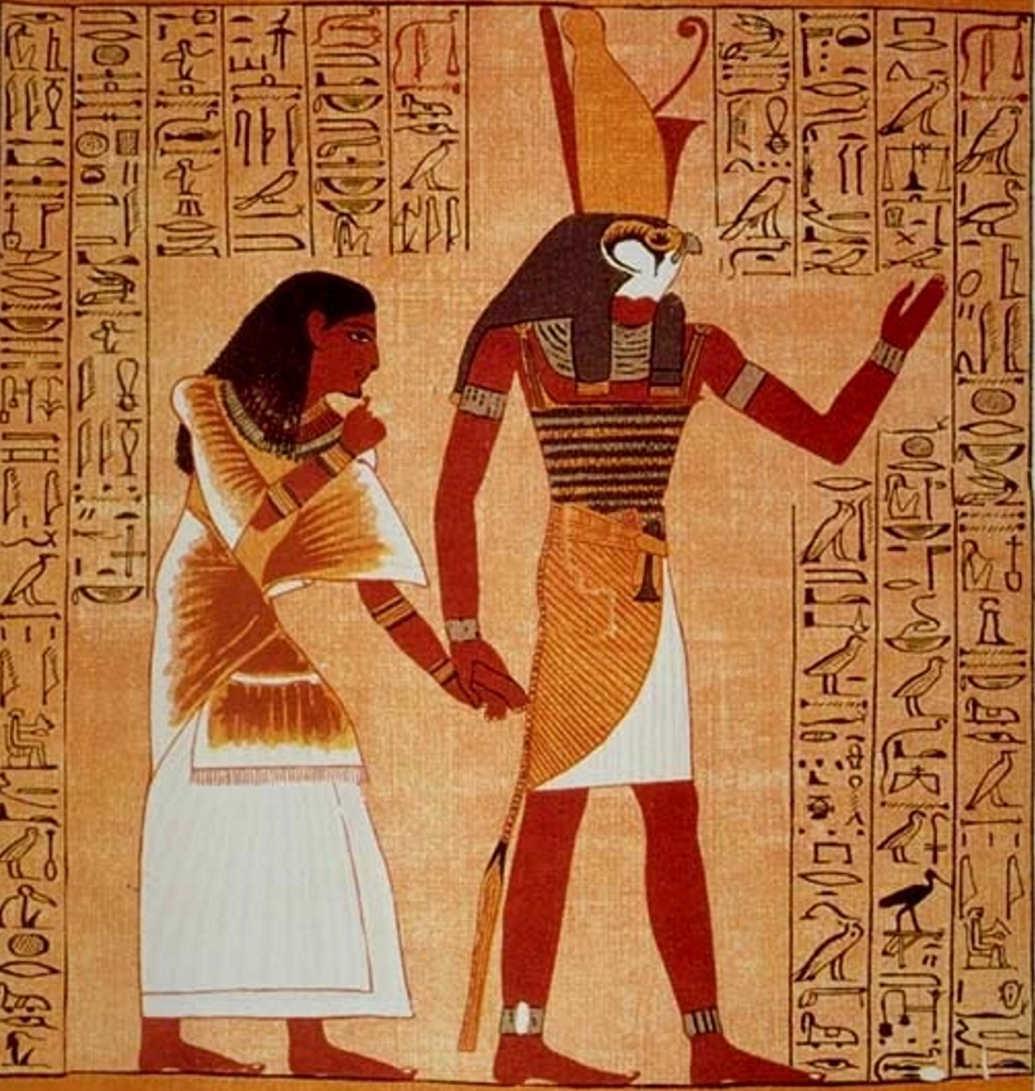
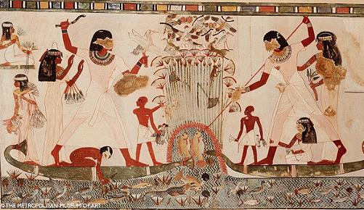
EGYPT: ART
PAINTINGS
THEY ALSO REPRESENT GODS AND PHARAOHS, BUT SOMETIMES INCLUDE DETAILS OF EVERYDAY LIFE

Slide 21
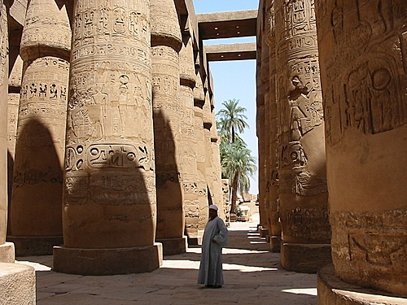
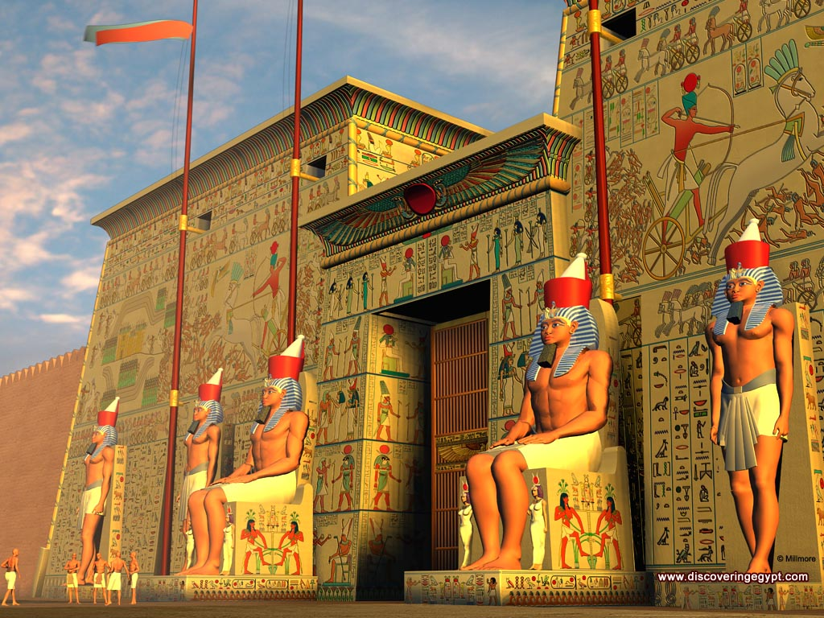
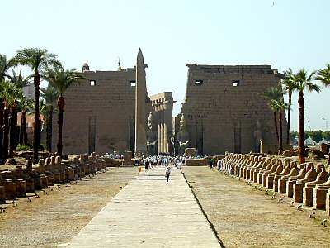
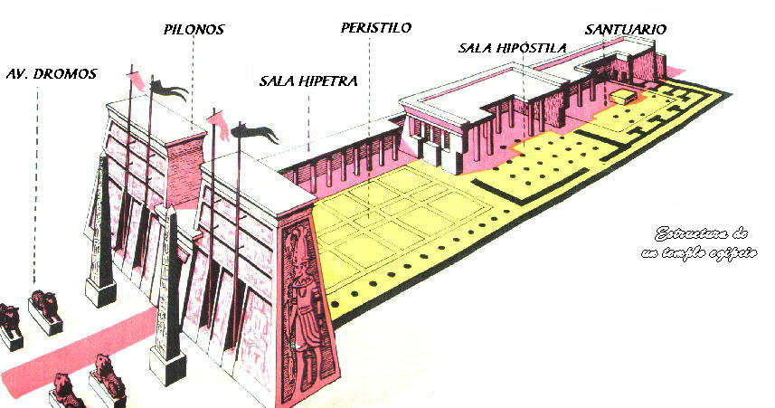
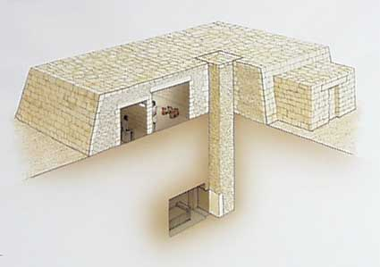
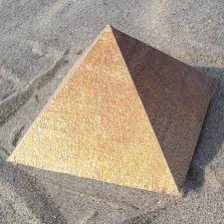
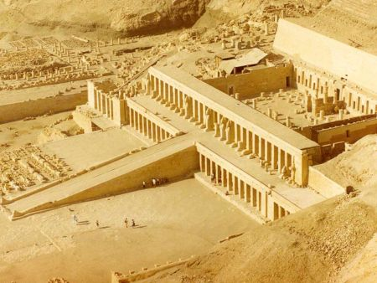
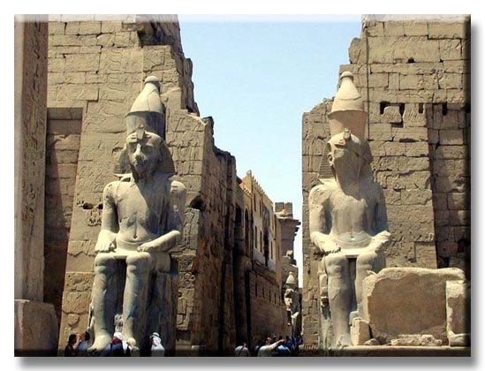
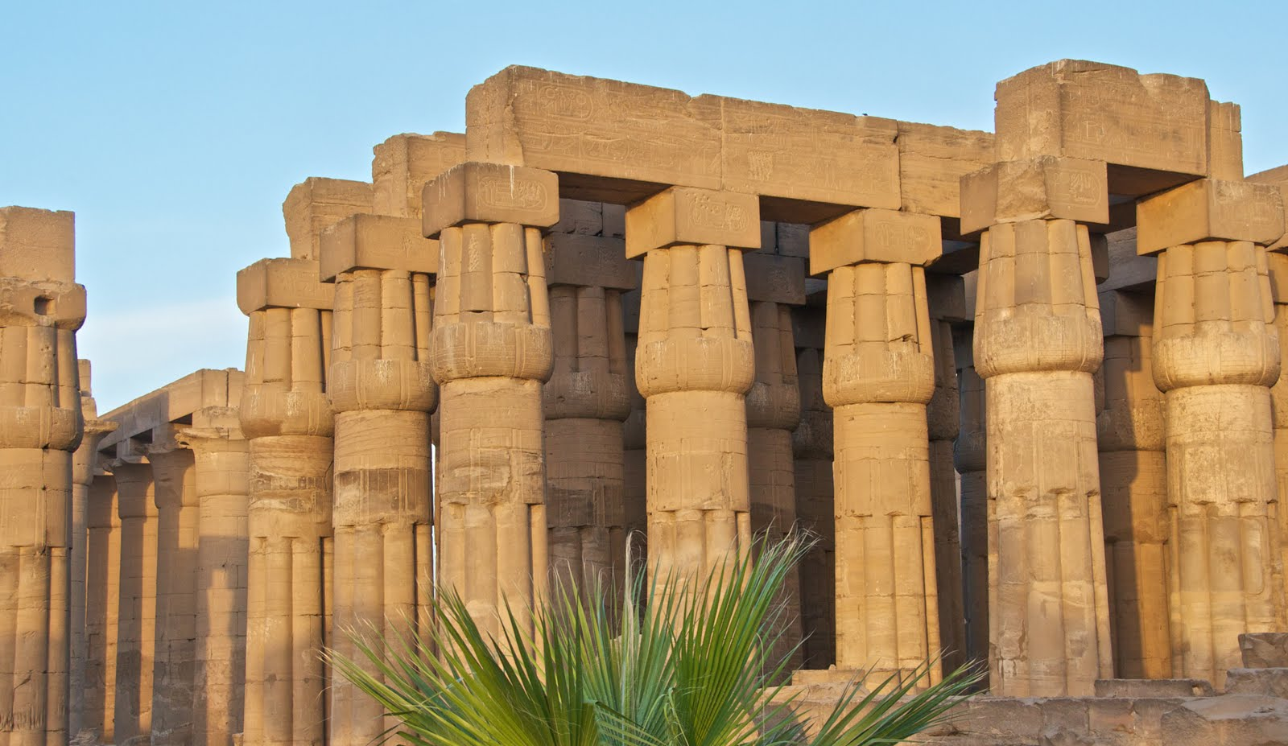
EGYPT: ARCHITECTURE
THE ANCIENT EGYTIANS BUILT HUGE TEMPLES AND TOMBS. THEY USED BIG STONES, COLUMNS AND WALLS. THEY DID NOT HAVE ARCHES OR DOMES.
PYLONS
COURTYARD
INNER SANCTUARY
SANCTUARY
SPHYNX AVENUE
COLONNADE
COMPARE IT WITH MESOPOTAMIAN ARCHITECTURE
OBELISK
THE TEMPLES WERE STONE BUILDINGS WITH AN IMPRESSIVE ENTRANCE, COURTYARDS AND ROOMS THAT LED TO THE GOD´S SANCTUARY. THERE WERE GREAT TEMPLES AT KARNAK AND LUXOR
THERE WERE THREE TYPES OF TOMBS
EGYPTIAN CULT TEMPLES VERSION 2 (1:49)
USEFUL INFORMATION…
MASTABAS
WERE LOW PYRAMIDS WITH A FLAT ROOF
PYRAMIDS
TOMBS FOR PHARAOHS THAT WERE BUILT WITH HUGE STONES AND WITH A FUNEREAL CHAMBER HIDDEN INSIDE
HYPOGEA
WERE TOMBS CARVED IN ROCK
LAS PIRÁMIDES (3:30). ARTEHISTORIACOM.
IN SPANISH

Slide 22
EGYPT: ARCHITECTURE
LABEL THE PARTS OF THE EGYTIAN TEMPLE IN THE DIAGRAM BELOW

