Slide 1
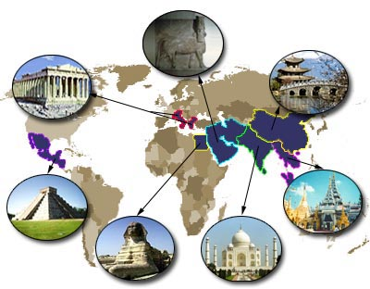
UNIT 9
MESOPOTAMIA

Slide 2
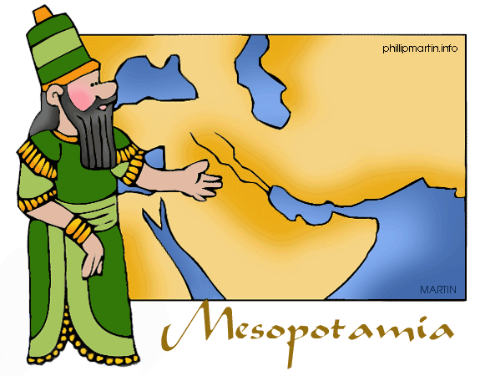
IN THIS UNIT YOU WILL…
Learn where early civilisations developed
Understand the importance of riveres in early civilisations
Learn about the political organisation of Ancient Egypt and Mesopotamia
Learn about the society and culture of early civilisations

Slide 3
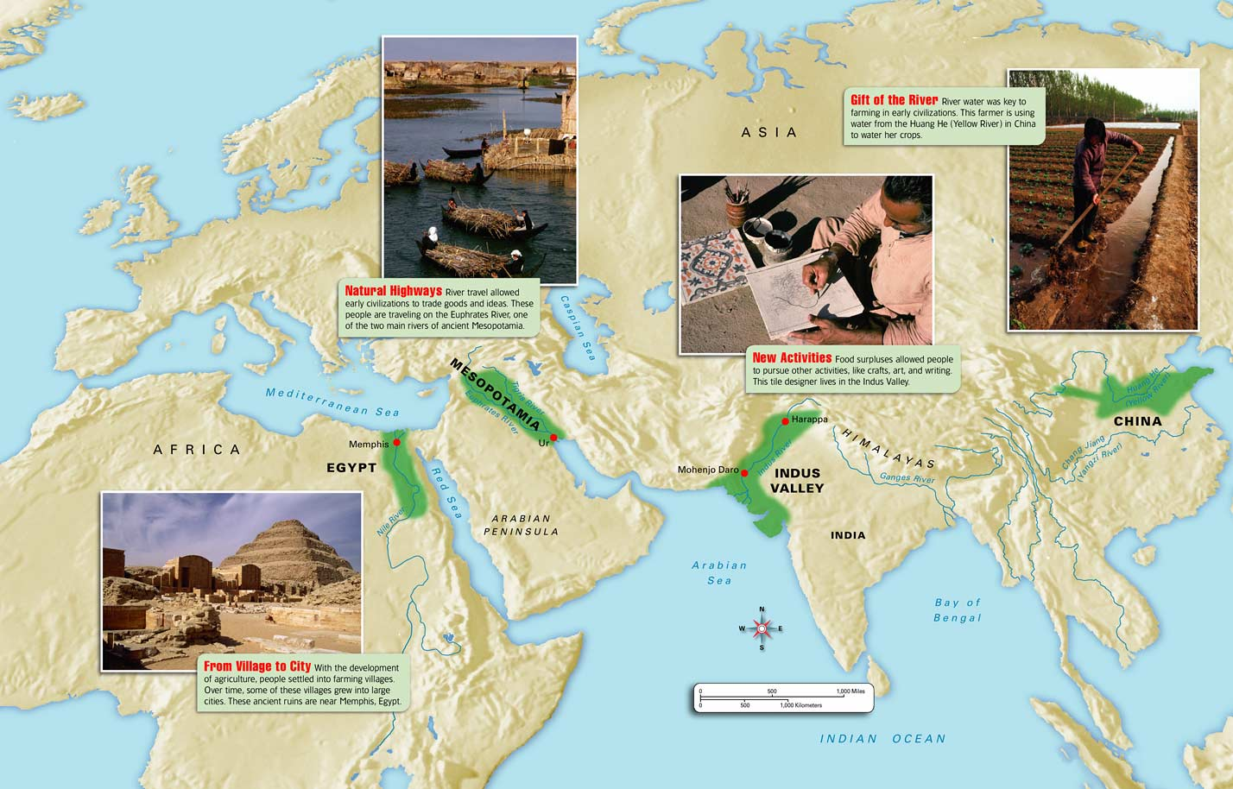
RIVER CIVILISATIONS
MESOPOTAMIA WAS LIKE OTHER PARTS OF THE WORLD, SUCH AS EGYPT, INDIA AND CHINA AN AREA IN WHICH THE FLOODING OF GREAT RIVERS FERTILISED THE LAND AND AGRICULTURE DEVELOPED. AS A RESULT SMALL SETTLEMENTS GREW INTO CITIES

Slide 4
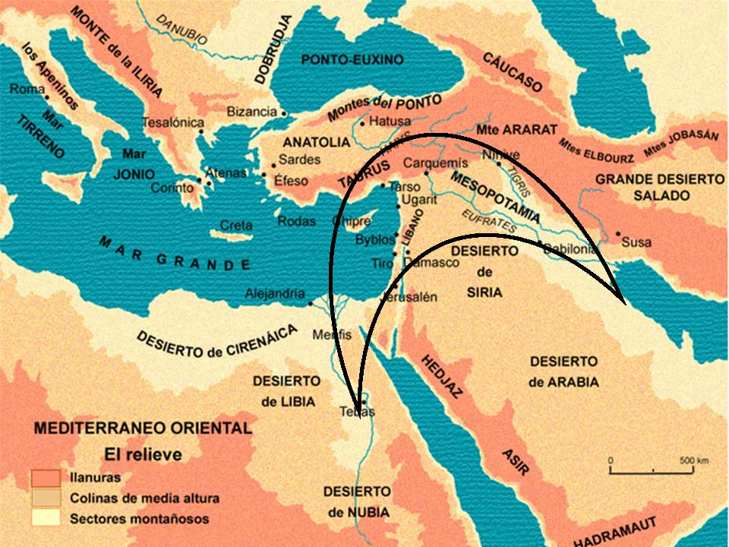
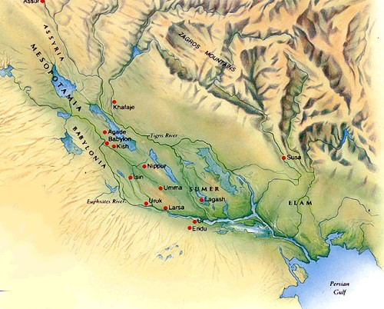
MESOPOTAMIA
ENVIRONMENT AND HISTORY
SEVERAL IMPORTANT CIVILISATIONS DEVELOPED IN THE MIDDLE EAST PLAINS ALONG THE TIGRIS AND EUPHRATES RIVERS. THIS AREA WAS LATER CALLED MESOPOTAMIA, WHICH MEANS “BETWEEN THE RIVERS” IN GREEK

Slide 5
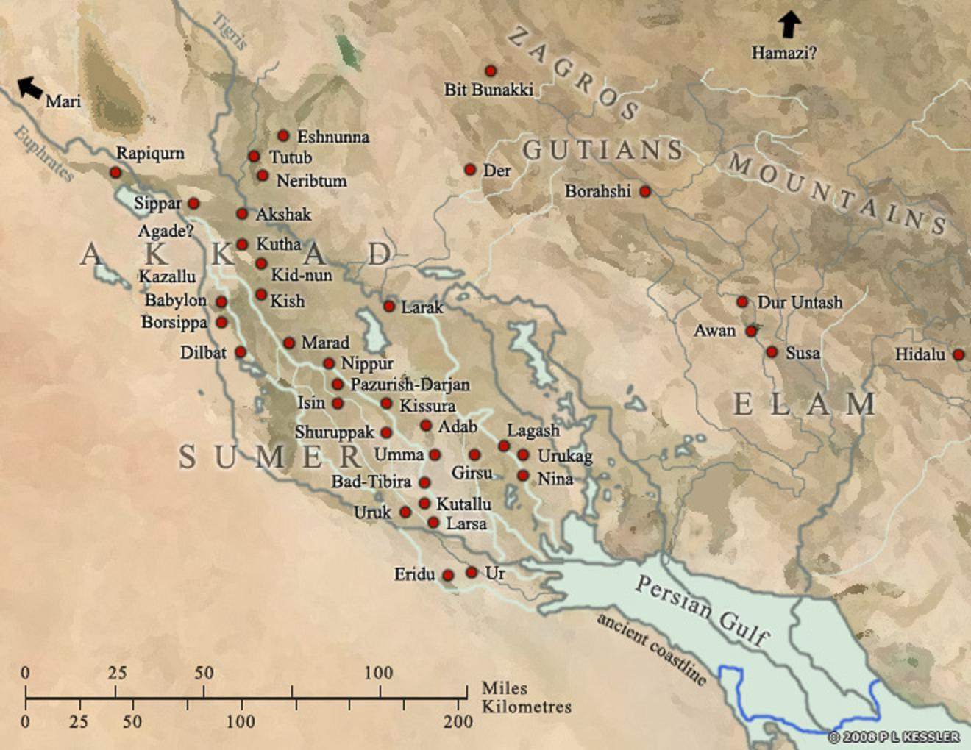
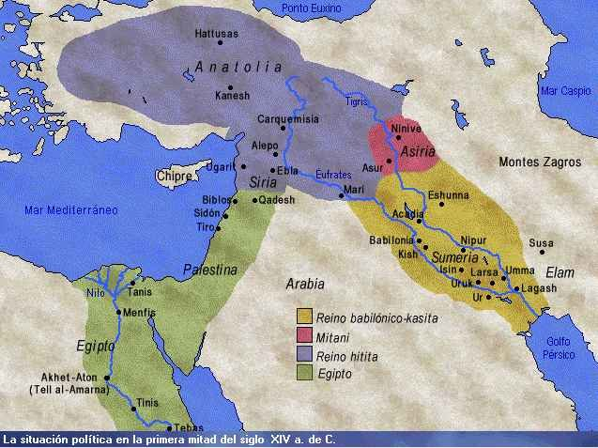
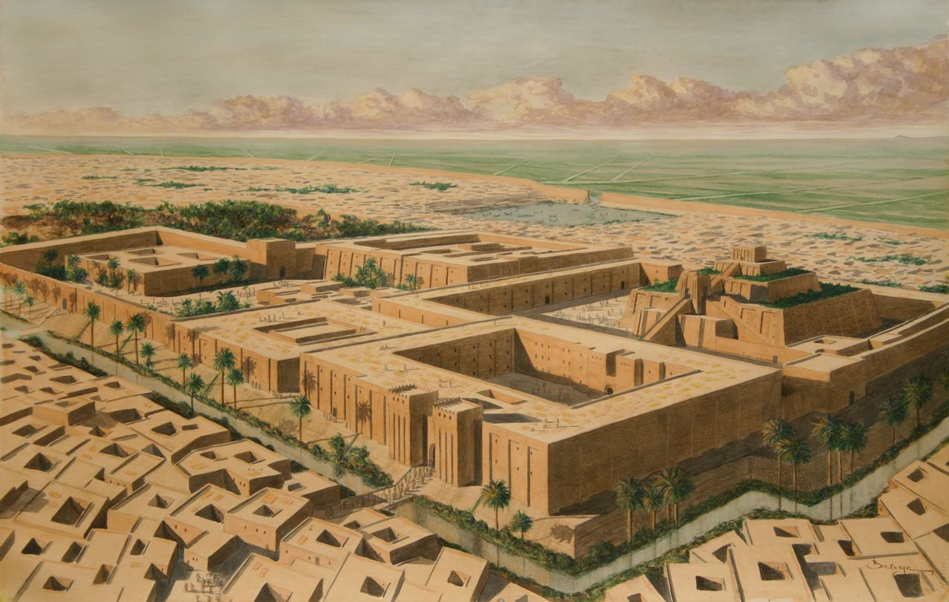
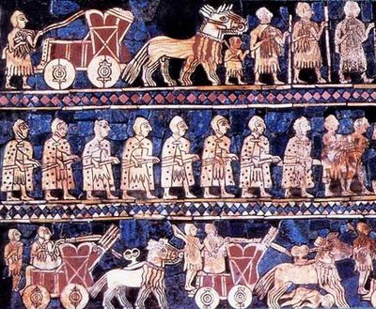
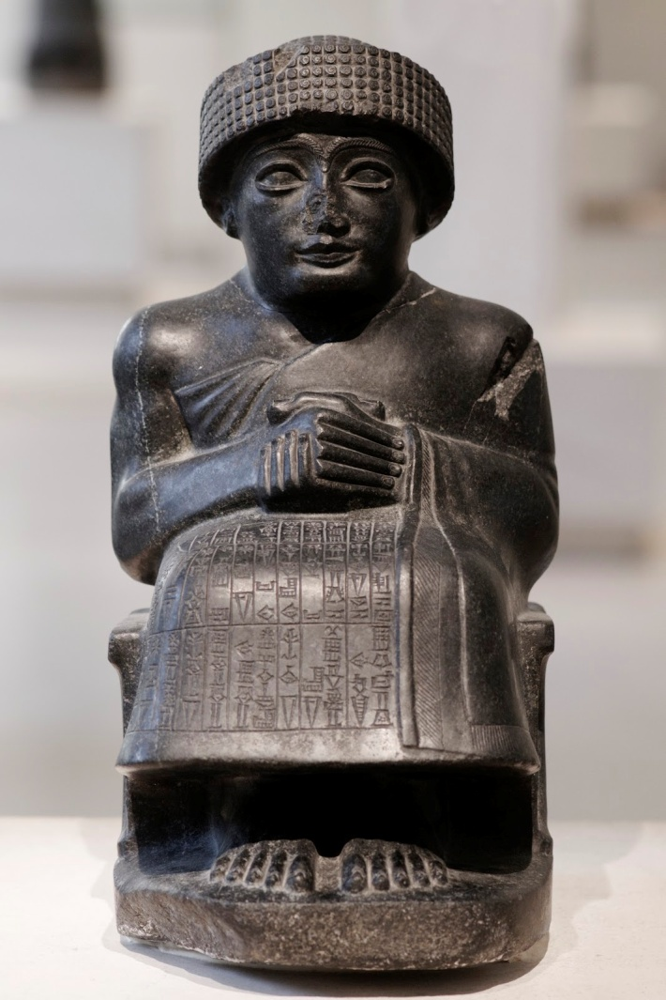
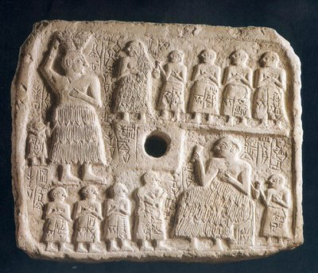
MESOPOTAMIA
CITY STATES AND EMPIRES
SUMER
Many people lived in Mesopotamia in independent city states. The region belonged to different empires over a long period of time
From 3500BC the Sumerians lived in walled city states such as Ur and Lagash

Slide 6
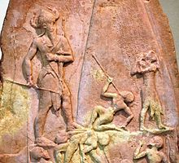
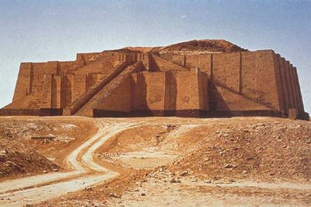
MESOPOTAMIA
CITY STATES AND EMPIRES
AKKAD
KING SARGON I CREATED AN AKKADIAN EMPIRE AFTER 2300BC AND CONQUERED SUMER

Slide 7
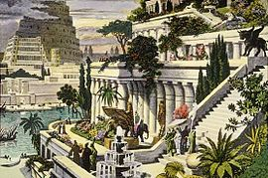
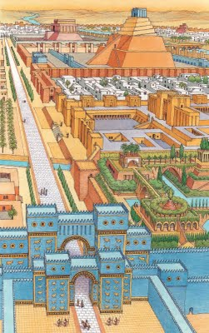
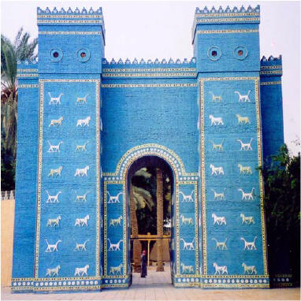
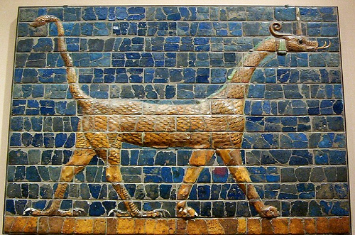
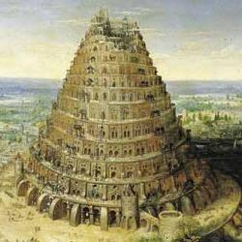
BABYLON
MESOPOTAMIA
CITY STATES AND EMPIRES
BABYLON WAS ORIGINALLY A CITY STATE. FROM 1800 ITS RULERS CREATED A GREAT EMPIRE THAT STRETCHED ACROSS TO THE MEDITERRANEAN COAST AND EGYPT
Many people lived in Mesopotamia in independent city states. The region belonged to different empires over a long period of time

Slide 8
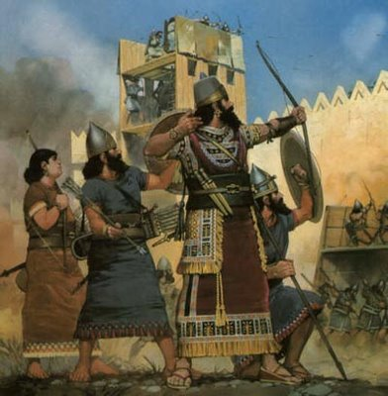
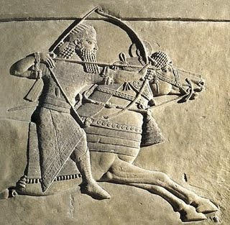
ASSYRIA
MESOPOTAMIA
CITY STATES AND EMPIRES
AFTER 1350BC THE ASSYRIANS CREATED A GREAT EMPIRE THAT STRETCHED ACROSS TO THE MEDITERRANEAN COAST AND EGYPT

Slide 9
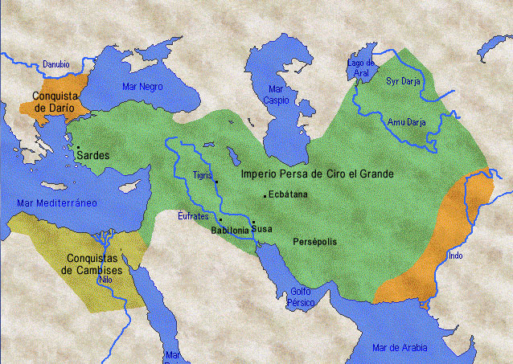
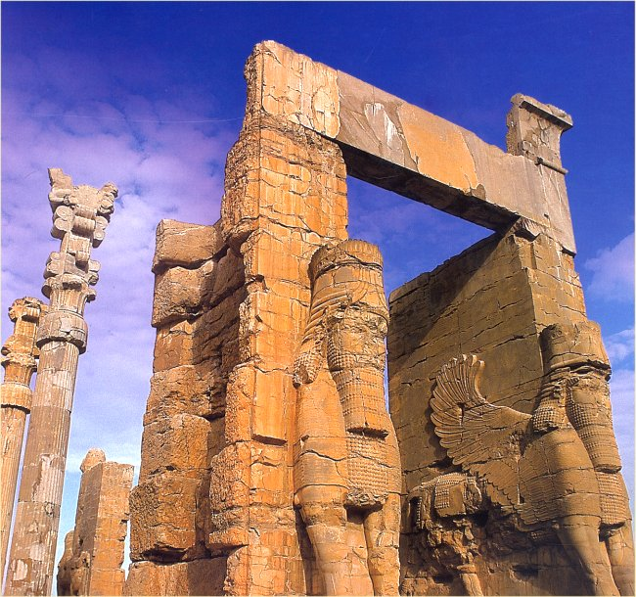
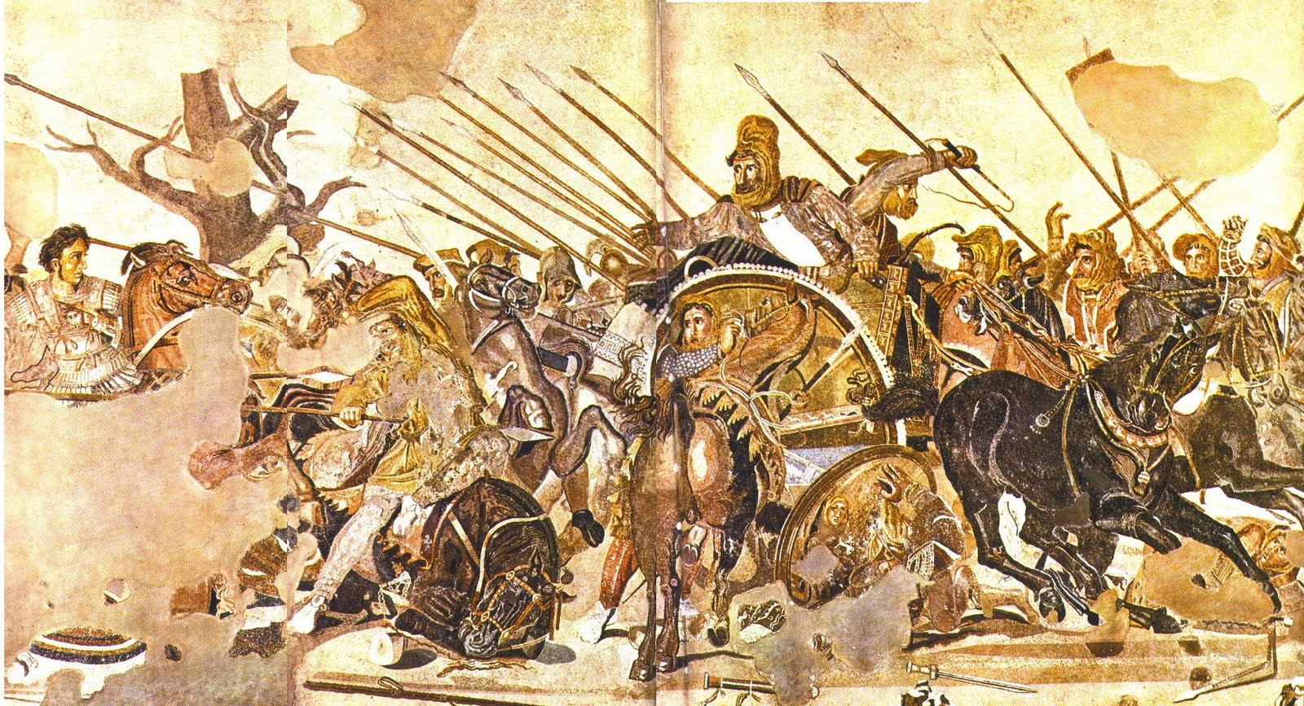
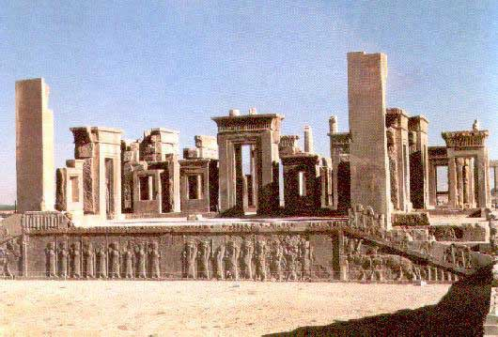
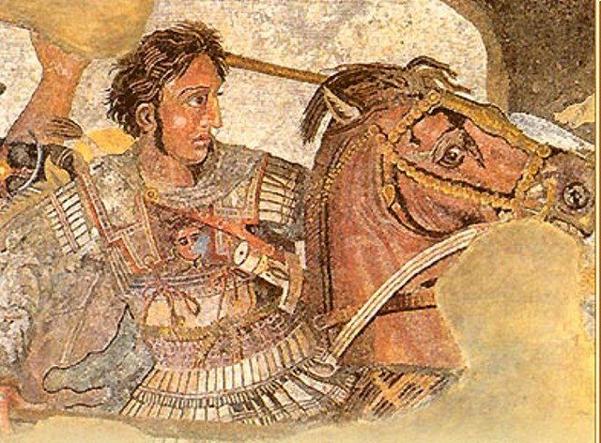
PERSIANS
MESOPOTAMIA
CITY STATES AND EMPIRES
ALEXANDER THE GREAT
IN 539 BC THE PERSIANS CONQUERED MESOPOTAMIA AND IT BECAME PART OF THE PERSIAN EMPIRE. MESOPOTAMIA WAS LATER CONQUERED BY THE GREEKS (ALEXANDER THE GREAT)

Slide 10
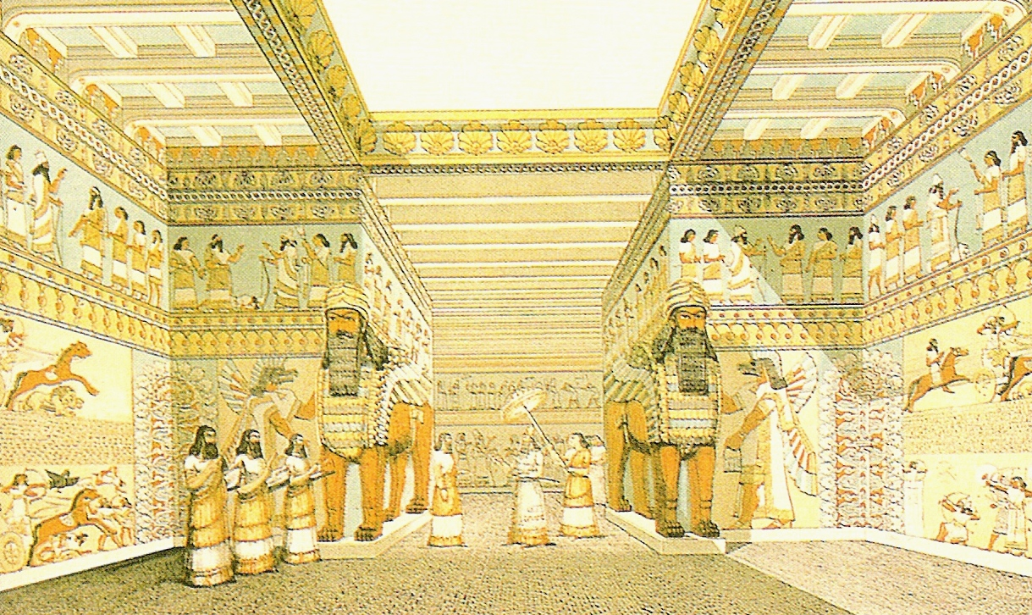
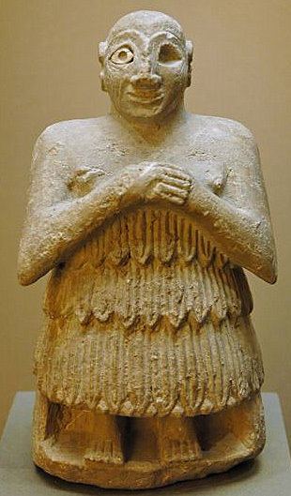
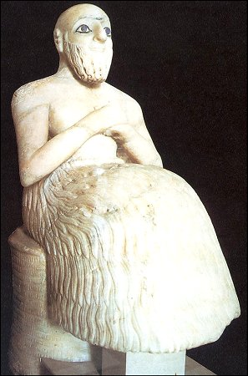
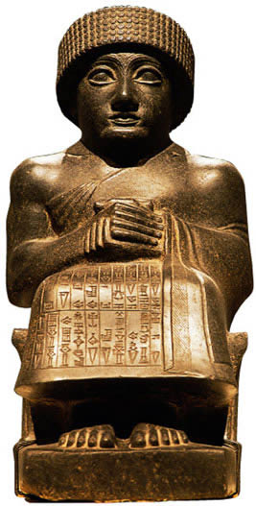
SOCIETY AND POLITICAL SYSTEMS
The city states of Sumer were ruled by high priests
What does theocracy mean?
We use the term theocracy to describe this type of society, where the same person had both religious and political power
The empires –when they were created- were ruled by their kings that held political and religious authority
They were also military leaders
GUDEA OF LAGASH

Slide 11
MESOPOTAMIA
HIERARCHICAL SOCIETY
KING
ARISTOCRACY
PRIESTS
ARTISANS
HIGH OFFIC IALS
MERCHANTS
FARMERS
SCRIBES
SLAVES
THE RULING ELITE
INTERMEDIATE GROUPS
LOWER LEVEL
BASE

Slide 12
MESOPOTAMIA
HIERARCHICAL SOCIETY
NOW, COMPLETE THE DIAGRAM OF THE MESOPOTAMIAN SOCIETY BY YOURSELF
KING
THE RULING ELITE
INTERMEDIATE GROUPS
LOWER LEVEL
BASE

Slide 13
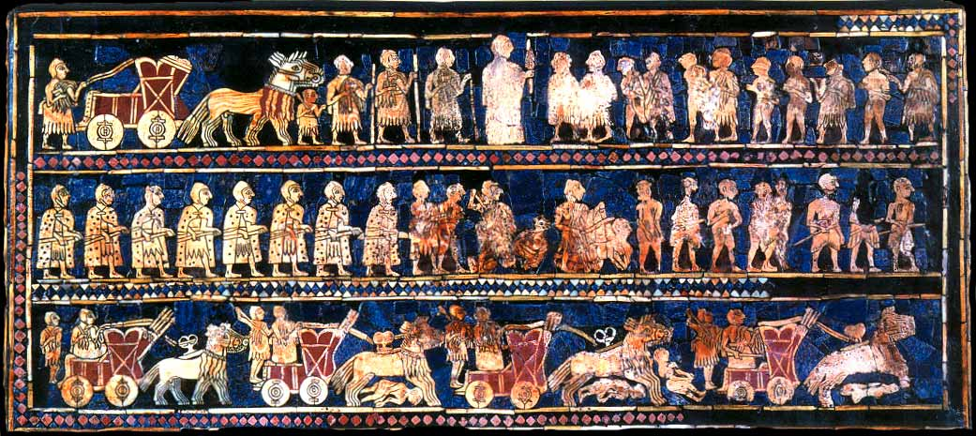
NOW, TRY TO IDENTIFY SOME OF THE DIFFERENT CLASSES IN THE STANDARD OF UR
WHERE IS THE MILITARY AND RELIGIOUS LEADER?
IS HE THE SAME SIZE AS THE OTHER FIGURES?
FIND WARRIORS AND CHARIOTS IN THIS SCENE
FIND THE DEFEATED ENEMIES

Slide 14
THE STANDARD OF UR
THE MILITARY AND RELIGIOUS LEADER
THE NOBLEMEN
THE WARRIORS
THE DEFEATED ENEMIES

Slide 15
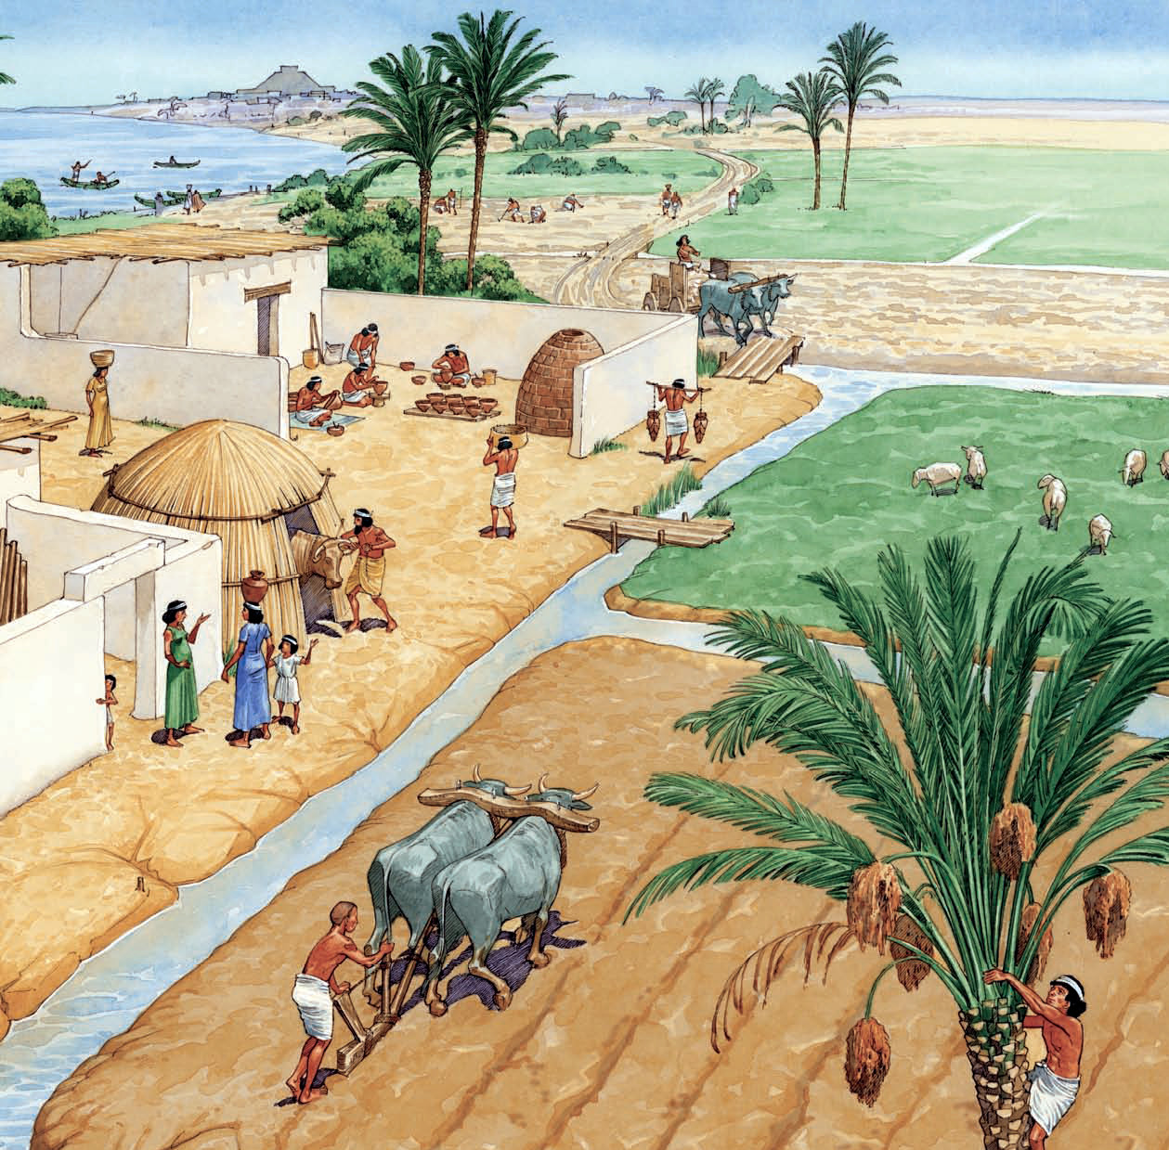
MESOPOTAMIA
THE ECONOMY
WHAT WERE THE MAIN ECONOMIC ACTIVITIES IN MESOPOTAMIA?
(2 MINUTES TO WORK IN GROUPS)
AGRICULTURE: THE RIVERES WERE ESSENTIAL. CROPS WERE IRRIGATED WITH WATER FROM CANALS, AND DYKES WERE BUILT TO PREVENT THE RIVERS FROM FLOODING. THEY GREW CEREALS AND VEGETABLES
LIVESTOCK: THEY KEPT SHEEP AND COWS
CRAFTS: THEY PRODUCED WOOL FOR CLOTH, POTTERY, METAL WORK AND JEWELLERY
TRADE: PRODUCTS WERE EXCHANGED BETWEEN THE REGIONS

Slide 16
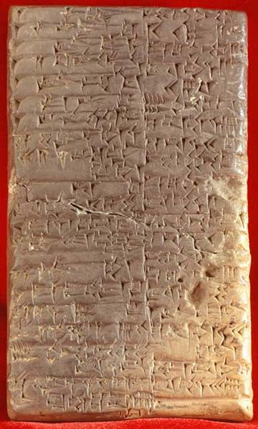
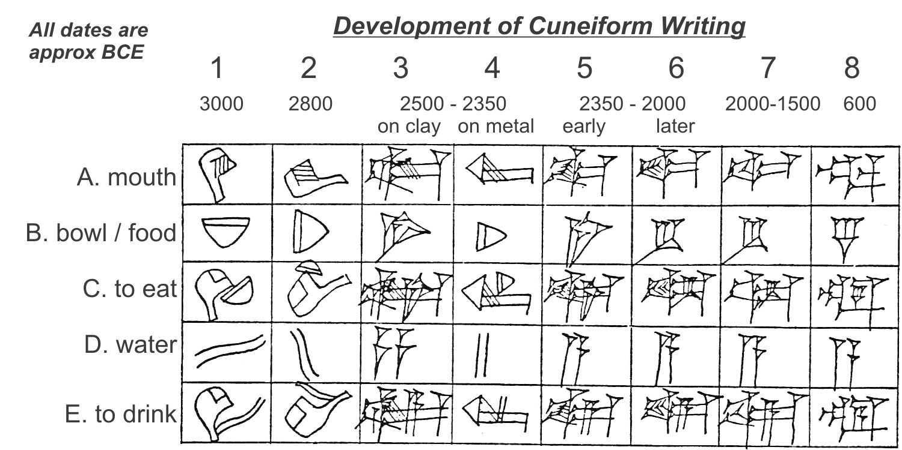
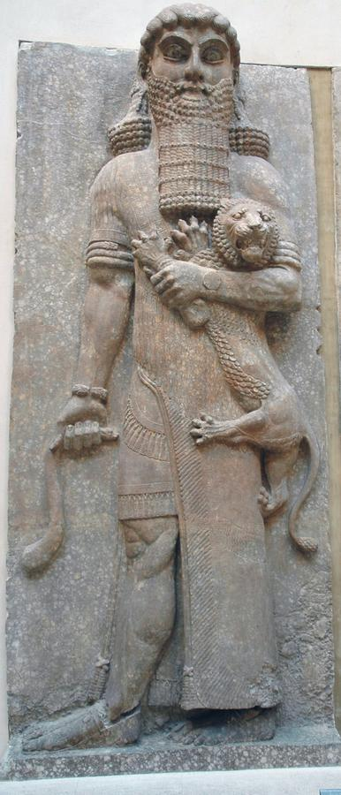
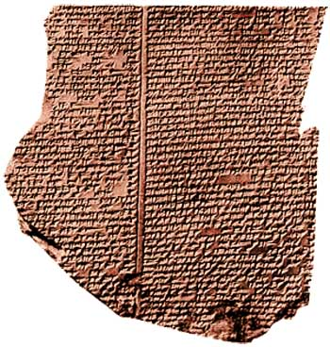
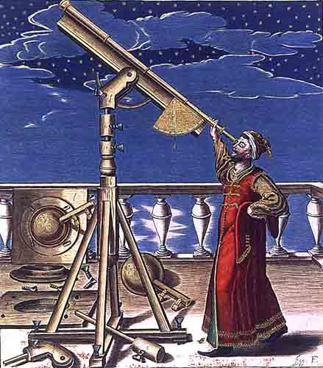
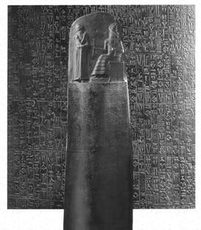
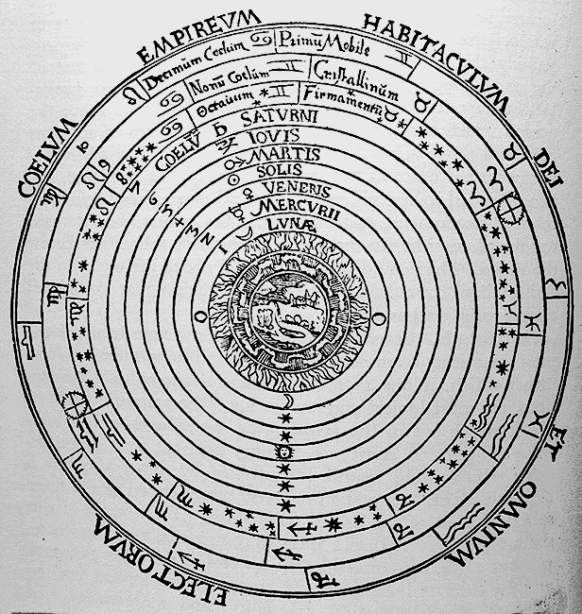
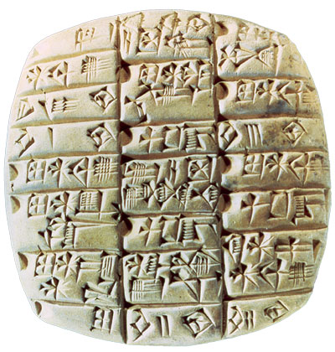
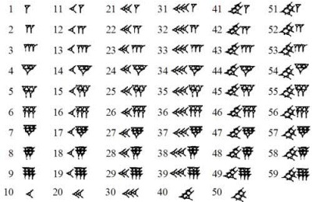
MESOPOTAMIA: CULTURE
ASTRONOMY
MESOPOTAMIANS OBSERVED THE STARS AND INVENTED A LUNAR CALENDAR
MATHEMATICS
MESOPOTAMIANS INVENTED NUMBERS, AND COULD COUNT AND WEIGH OBJECTS
WRITING
Mesopotamia, explicación de la escritura cuneiforme. (3:06)
By Hernán Pérez del Pulgar
APPEARED IN MESOPOTAMIA AFTER 4000 BC. SMALL PICTURES REPRESENTED OBJECTES OR ANIMALS AND EVOLVED INTO . AT FIRST, WRITING WAS USED FOR PUBLIC ADMINISTRATION, BUT AFTER IT RECORDED POEMS AND STORIES
Hammurabi's code of law & the Israelite connection (2:54)
By Ashraf Ezrat
LITERATURE
LONG POEMS LIKE THE EPIC OF GILGAMESH WERE WRITTEN (2000 BC). THE WAS THE WORLD´S FIRST WRITTEN LAW (1750 BC)
Hammurabi´s Code (2,55)
By CCMS Cougarcast

Slide 17
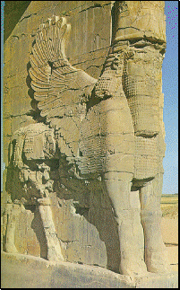
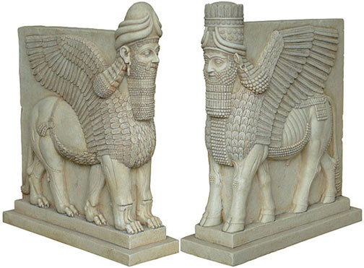
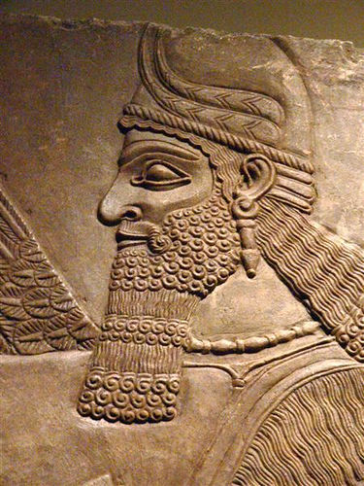
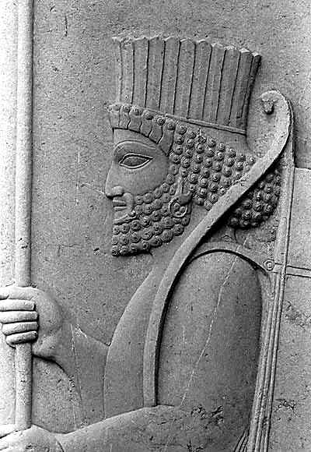
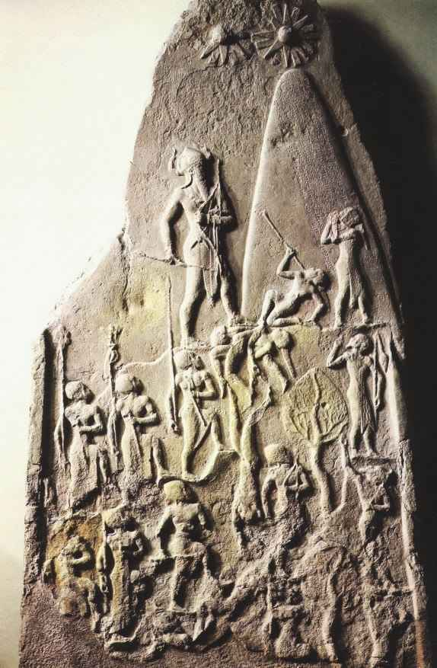
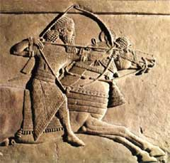
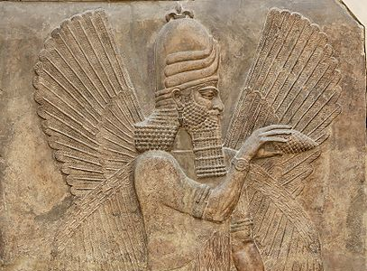
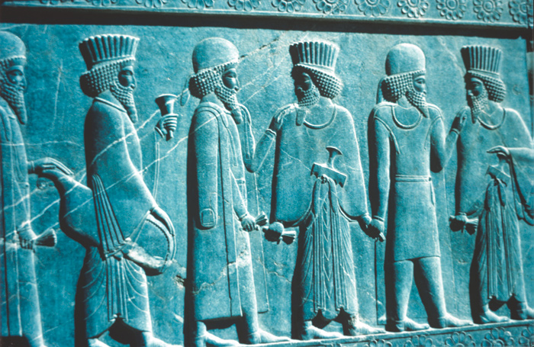
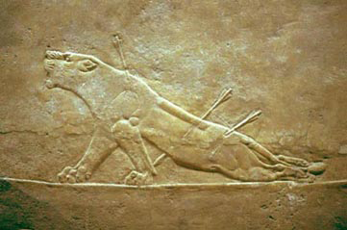
MESOPOTAMIA: CULTURE
SCULPTURE
STATUES
RELIEFS
STATUES SHOWED KINGS, GODS AND PRIESTS
CARVED RELIEFS SHOWED HUNTING SCENES OR MILITARY VICTORIES
COMPARE THESE TWO RELIEFS.
WHAT DIFFERENCES CAN YOU APPRECIATE?
AND NOW, CAN YOU SEE ANY DIFFERENCE BETWEEN THESE TWO WINGED BULLS?

Slide 18
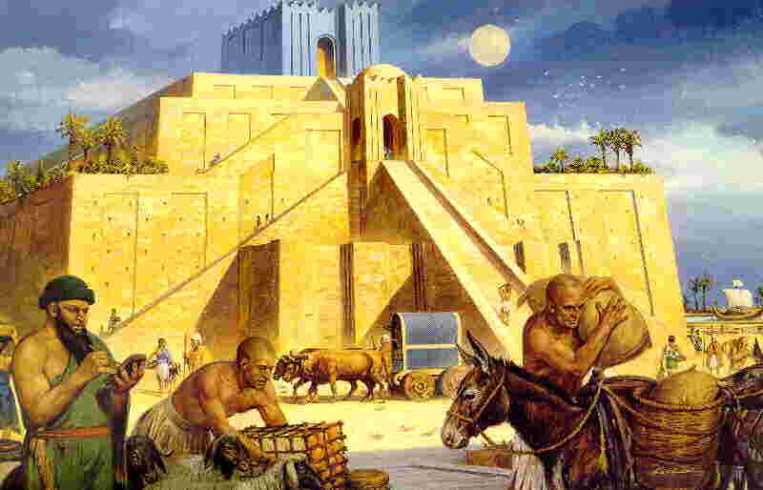
MESOPOTAMIA: ARCHITECTURE
IMPORTANT INNOVATIONS IN MESOPOTAMIAN ARCHITECTURE WERE THE ARCH AND THE DOME
MANY BUILDINGS WERE MADE FROM ADOBE (DRIED CLAY) BRICKS, AND HAVE SINCE DISAPPEARED.
HOWEVER, SOME PALACES AND TEMPLES HAVE SURVIVED
PALACES HAVE IMPRESSIVE FACADES, COURTYARDS, PRIVATE ROOMS AND LIBRARIES
TEMPLES WERE GROUPS OF BUILDINGS. THEY INCLUDED ZIGGURATS, WHICH WERE PYRAMID-SHAPED TOWERS WITH SEVERAL LEVELS

